Slide 1
Universal Design
For Learning &
Information Literacy
Carli Spina
@CarliSpina

Slide 2
What is Universal Design?
“Universal design is the design of products and environments to be usable by all people, to the greatest extent possible, without the need for adaptation or specialized design.”
- Ronald L. Mace

Slide 3
What is Universal Design for Learning?
“A framework for designing educational environments and products…that are accessible and optimal for all learners.”
- Prof. David Rose

Slide 4
Notes:
Engagement – offer variable levels, content types, and tools to appropriately challenge each learner and, just as importantly, capture their interest.
Representation – Present the information multiple ways to support for all learners
Action and Expression – Provide more than one way for learners to demonstrate their skill and learning

Slide 5
UDL
&
Technology

Slide 6
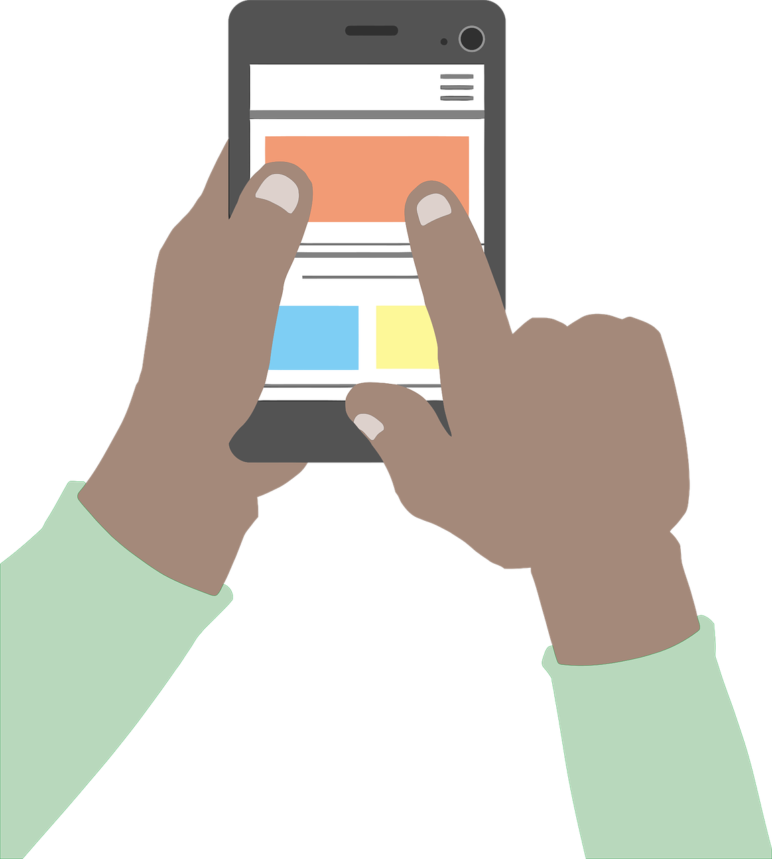
“UDL is about design. Design is fundamentally about problem solving. Instructional design is about the efficacy of learning. Central to all of these constructs is evidence of intentionality and how problems can be resolved through innovative design. Technology is simply the delivery system.”
Dave L. Edyburn

Slide 7
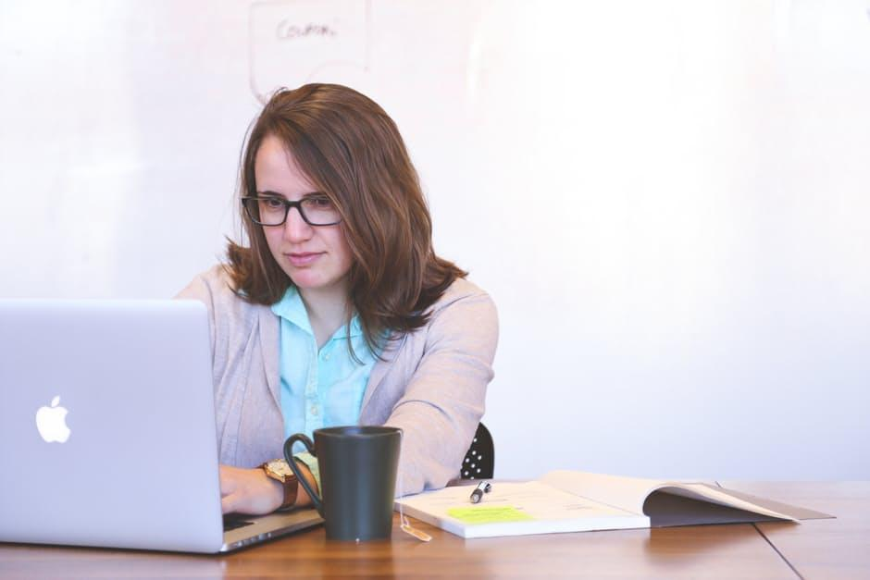
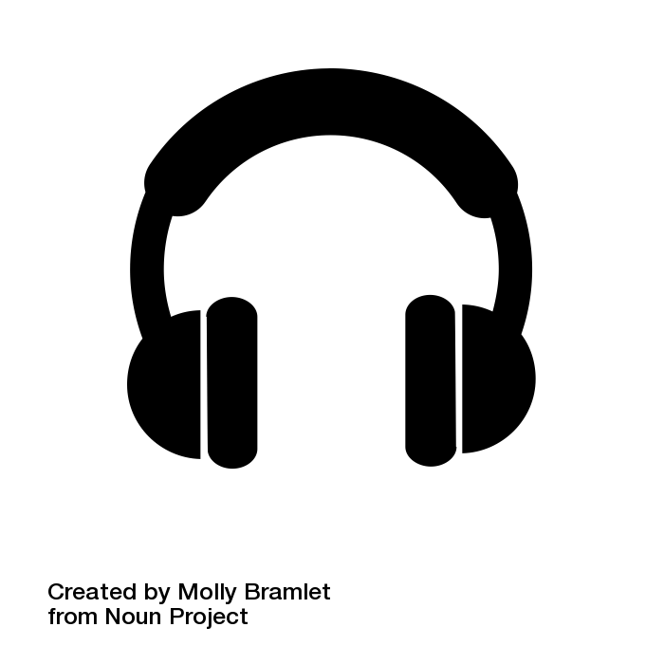

Slide 8
UDL &
Information Literacy

Slide 9
Info Literacy & UDL
Effective for both synchronous & asynchronous content
Can work at multiple levels of technological integration

Slide 10
UDL & The ACRL Framework
“Students have a greater role and responsibility in creating new knowledge, in understanding the contours and the changing dynamics of the world of information, and in using information, data, and scholarship ethically.”
http://www.ala.org/acrl/standards/ilframework

Slide 11
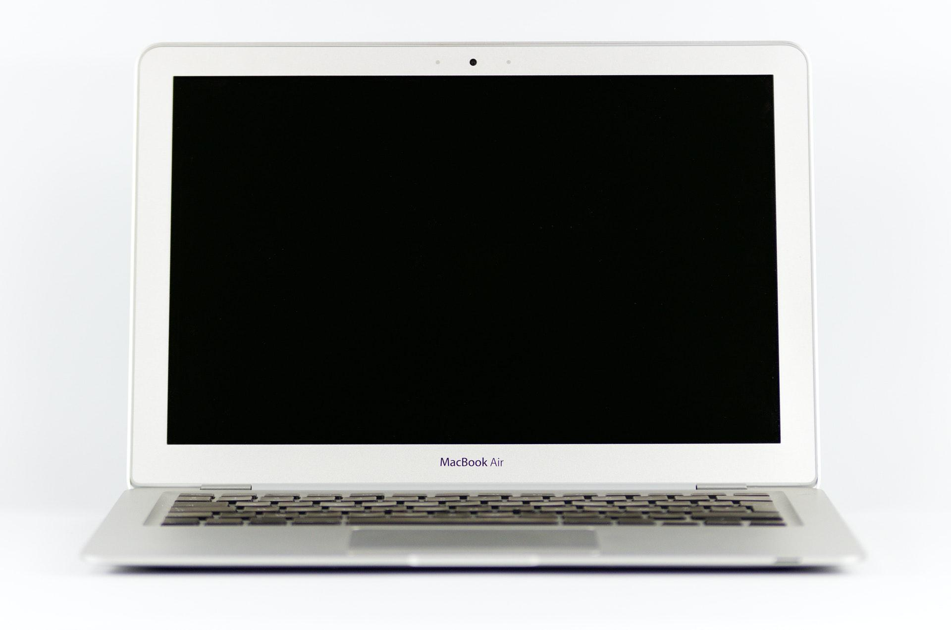
UDL
During
Covid-19

Slide 12
UDL & COVID-19
Dark Cloud
Rapid, unexpected changes did not allow time to evaluate tools
Resources are limited
Stress levels are high for librarians, educators, & learners

Slide 13
UDL & COVID-19
Silver Lining
Opportunities for personalization
Adoption of new technologies can facilitate UDL
UDL offers the tools & techniques to support learners

Slide 14
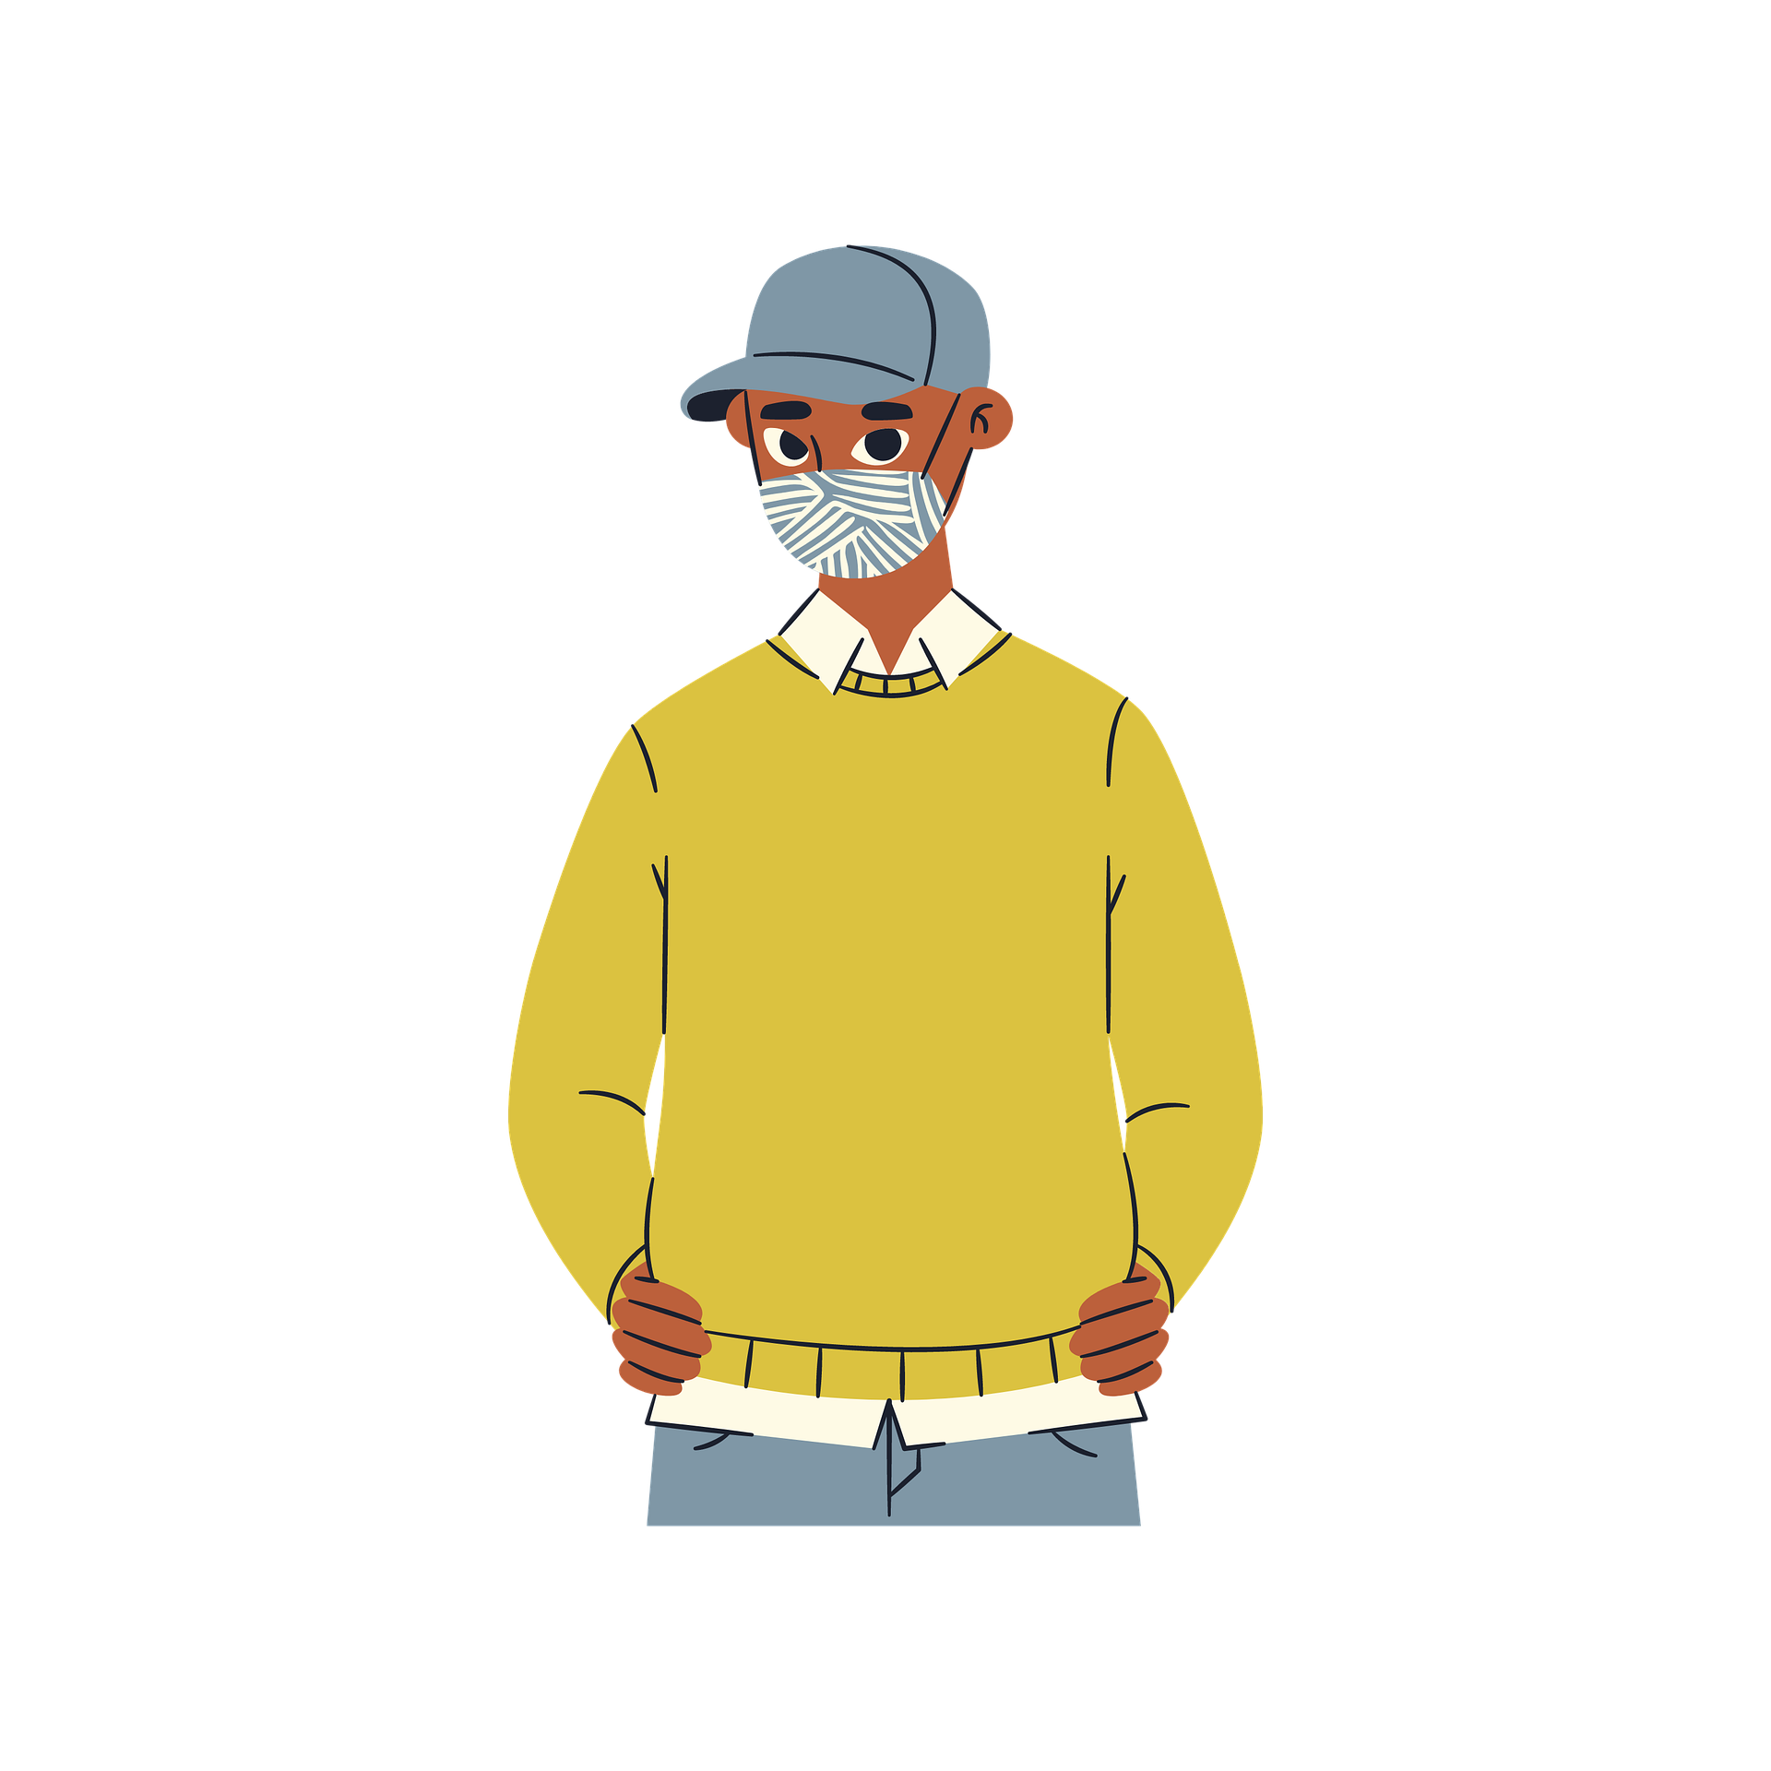
Using UDL to Support Remote Learners
Offer additional support for executive function
Maximize choice at every step
Link to extra information to aid in comprehension

Slide 15
Using UDL to Support Remote Learners
Integrate opportunities for collaboration
Offer advice and training on tools for managing resources
Focus on the UDL guidelines when evaluating tools & design

Slide 16
Applying UDL to Remote Learning
Integrate multimedia
Test for assistive device compatibility
Integrate scaffolding
Offer progress monitoring options

Slide 17
“The standard does not change because of situations or hardships. The standard is communicated, and the road to reach the standard is paved with flexibility.”
Andratesha Fritzgerald

Slide 18
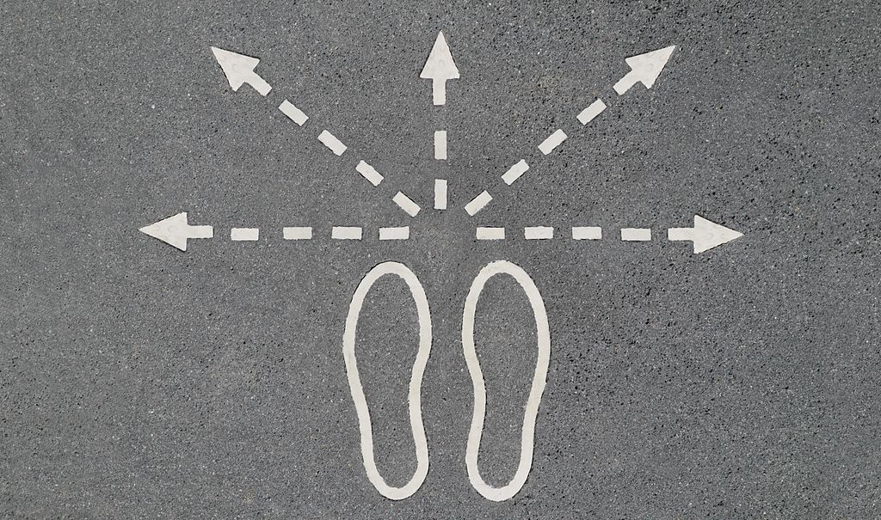

Slide 19
Carli Spina
@CarliSpina
carli.spina@gmail.com

