Slide 1
Universal Design for Learning (UDL) for Inclusive Teaching and Learning
Clayton A. Copeland and Kim M. Thompson
University of South Carolina
School of Information Science
23 September 2020
IFLA Webinar
Using Universal Design for Learning to Enhance Information Literacy Programs: Online and in the Library

Slide 2
Universal Design for Learning (UDL) and inclusive teaching and learning
What is UDL?
Why is UDL important for all students, with and without disabilities?

Slide 3
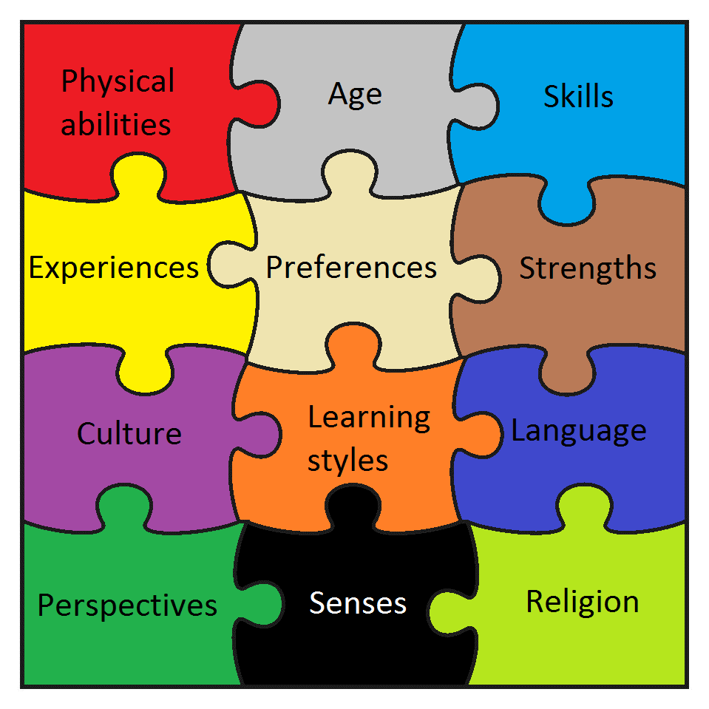
Today’s Learners and Learning Environments
This Photo by Unknown Author is licensed under CC BY-NC

Slide 4
Universal Design for Learning
Universal design is “the design of products and environments to be usable by all people, to the greatest extent possible, without the need for adaptation or specialized design” (Center for Universal Design, 2019, n.p.).

Slide 5
University of South Carolina Center for Teaching Excellence: Accessibility Guides and Tutorials
https://www.sc.edu/about/offices_and_divisions/cte/instructional_design/accessibility/index.php

Slide 6
Applying concepts of UDL and inclusive teaching and learning to learners with visual limitations
Microsoft Word “style” formatting; use headings and subheadings
Alt text for images
Upload both pdf and doc versions
Sans serif (Arial, Calibri) font at 12-point minimum for documents, larger for slides

Slide 7
Applying concepts of UDL and inclusive teaching and learning to learners with visual limitations, 2
Black or very dark fonts rather than color coded content
Be aware of spacing and layout on the screen/page, ordering slide panes, etc.
If using Microsoft Office, use Check Accessibility feature (be aware of limitations of the checker)

Slide 8
Applying concepts of UDL and inclusive teaching and learning to learners with hearing limitations
Record video lectures for reviewing
Provide copies of slides and notes
Close caption whenever possible--if closed captioning is not available, transcription afterward is second best or detailed handout that follows same presentation order

Slide 9
Applying concepts of UDL and inclusive teaching and learning to learners with hearing limitations, 2
Try to have video of your face when lecturing, with good resolution, especially if closed captioning is not available
Speak slowly with clear tone--shouting should be avoided

Slide 10
Applying concepts of UDL and inclusive teaching and learning to learners with mobility limitations
May not be apparent in F2F classroom but may raise barriers in online learning environments
Slower typing speeds; may need larger monitor or adaptive keyboards, roller ball, text-to-speech, sticky keys

Slide 11
Applying concepts of UDL and inclusive teaching and learning to learners with mobility limitations, 2
Recordings and transcripts of online meetings can help
Designated note-taker in online meeting
Reinforce verbal communications with written communications

Slide 12
Applying concepts of UDL and inclusive teaching and learning to learners with neurodiversit(ies)
Be explicit about how to ask for clarification
Set up a “Questions about Assignments” discussion board
Clear structuring and subheadings throughout lecture materials

Slide 13
Applying concepts of UDL and inclusive teaching and learning to learners with neurodiversit(ies), 2
Be clear about expectations for behavior in-class, on discussion boards, and with other communication
Scaffold assignments

Slide 14
Universal Design for Learning (UDL) and inclusive teaching and learning
Accessibility strategies intended for some learners will also be helpful to others
Accessibility helps ensure meaningful interactions and stronger learning outcomes

Slide 15
Answering Questions
Academics tend to underrate librarians when conducting information literacy programs. How has this issue been overcome world over?

Slide 16
Any more questions?

Slide 17
References
Burgstahler, S. (2017, January 30). ADA compliance for online course design. Educause Review.
Retrieved from https://er.educause.edu/articles/2017/1/ada-compliance-for-online-course-design
Center for Applied Special Technology. (2019). CAST: About us - Universal design for learning. Retrieved from
http://www.cast.org/our-work/about-udl.html#.XhZch5NKiu4

Slide 18
References, continued
Center for Universal Design. (2019). Retrieved from https://projects.ncsu.edu/ncsu/design/cud/

Slide 19
References, continued, 2
Copeland, C.A. (2019, January 16). Accessing ability through Universal Design for Learning: The challenge, the opportunity, the responsibility [Webinar]. ALISE Webinar Series.
Mallary, K. J. & Copeland, C.A. (2020, August 24). Universal design and Universal Design for Learning: Tools in equity of access [Webinar]. ALISE Webinar Series.
Thompson, K. M., & Copeland, C.A. (in press). Making the diversity, equity, and inclusion mindset indispensable in the LIS classroom through design, content, communication, and assessment. In K. Dali & N. Caidi (Eds.). Humanizing LIS education and practice: Diversity by design. Routledge.

Slide 20
References, continued, 3
Thompson, K.M., & Copeland, C.A. (in press). Making the diversity, equity, and inclusion mindset indispensable in the LIS classroom through design, content, communication, and assessment. In K. Dali & N. Caidi (Eds.). Humanizing LIS education and practice: Diversity by design. Routledge.

Slide 21
References, continued, 4
Thompson, K.M. & Copeland, C.A. (2020). Inclusive considerations for optimal online learning in times of disasters and crises. Information and Learning
Sciences, Special Issue: A Response to Emergency Transitions to Remote Online Education in K-12 and Higher Education, 121(7/8), 481- 486. https://doi.org/10.1108/ILS-04-2020-0083

