Slide 1
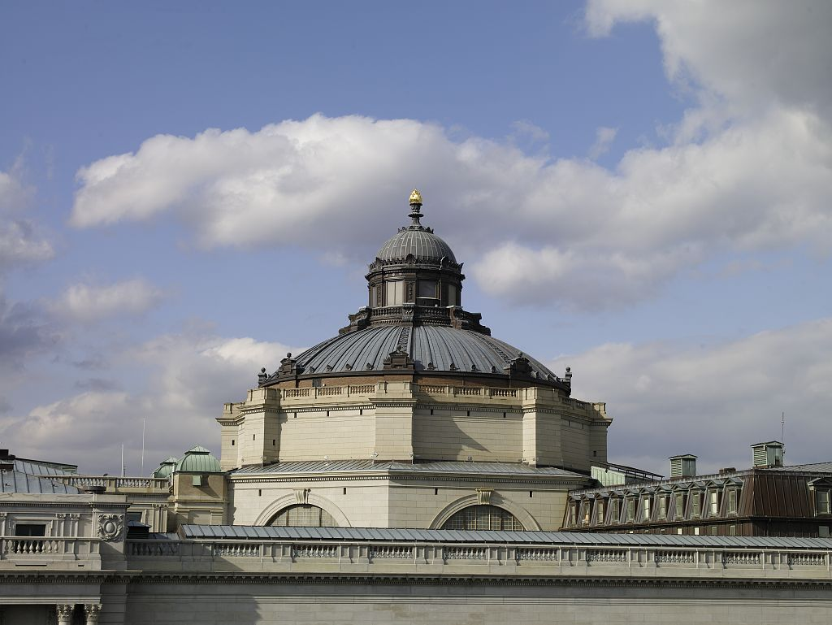
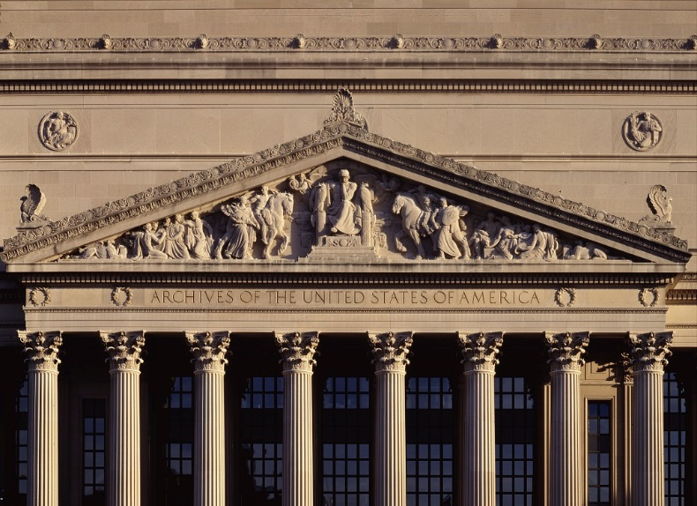
Kate Zwaard
Director of Digital Strategy Library of Congress
Institution as Social Media Collector: Lessons Learned from the Library of Congress and the National Archives and Records Administration
Dana Allen-Griel
Web and Social Media Branch Chief
National Archives and Records Administration
Notes:
I’m Kate Zwaard, the Director of Digital Strategy at the Library of Congress
I’ll be joined today by Dana Allen-Griel, for this joint presentation about social media collecting, and social media use
Images:
Highsmith, Carol M., [Exterior view. View of the roof, dome, and cupola. Library of Congress Thomas Jefferson Building, Washington, D.C.] https://www.loc.gov/item/2007684218/
Highsmith, Carol M., National Archives Building, Washington, DC https://www.loc.gov/item/2011630755/

Slide 2
Engage, inspire, and inform Congress and the American people with a universal and enduring source of knowledge and creativity
Notes:
This is our mission statement. We are one of very few libraries that has a collection development mandate so broad – a universal collection. No, we don’t have all the books, but we do try to collect broadly on many topics in many languages. Which is why we have so much material.

Slide 3
Notes:
Library as Collector
167 million items on approximately 838 miles of bookshelves
24 million general collections books
Earth’s largest collection of
Maps
Music scores
Legal Materials
Films
Sound Recordings
Comic Books
Telephone Directories (124,000)
It’s big and growing
About 20,000 tangible items arrive on the loading dock each week. through the U.S. Copyright Office About half of them get added to the collection. This means we add the equivalent of my hometown library to the Library of Congress every week

Slide 4
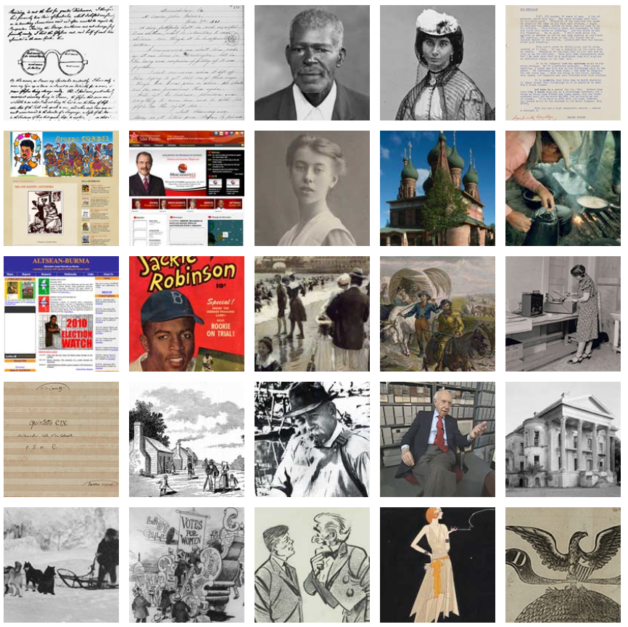
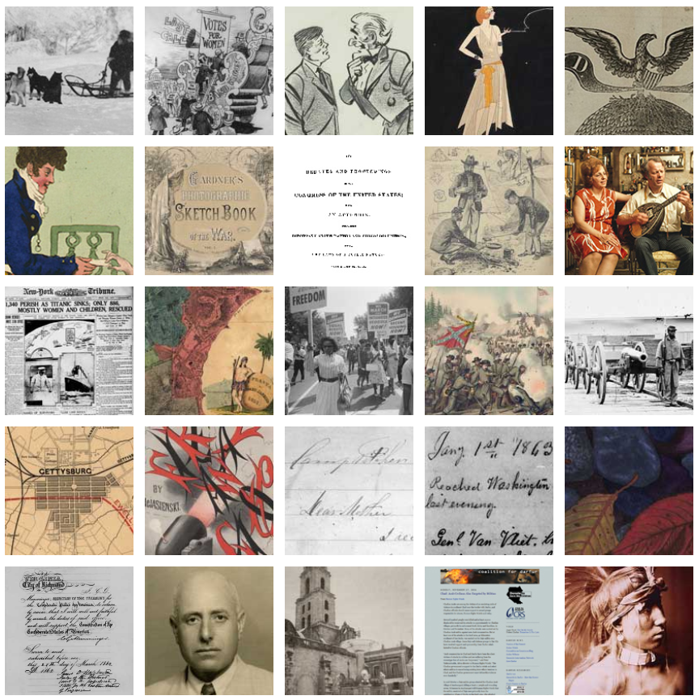
Notes:
These numbers don't even touch the digital collections, which is huge and growing. It includes material that has been digitized and our increasingly vast born digital collections. We have ejournals, ebooks, PDF government documents, websites.
In 2017, the Library published it’s first ever Digital Collecting Plan https://www.loc.gov/acq/devpol/CollectingDigitalContent.pdf
Image: Screenshots of collection thumbnails at https://www.loc.gov/collections/?st=grid

Slide 5
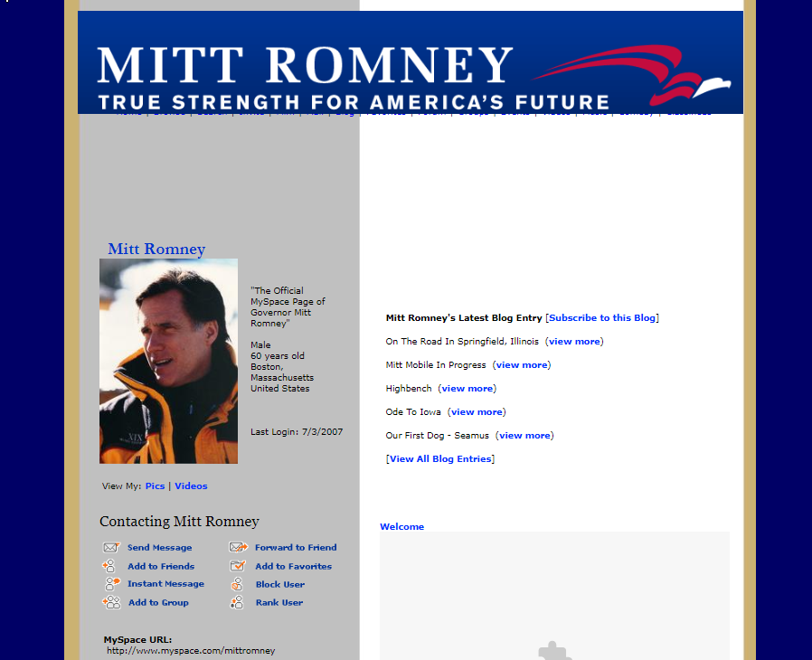
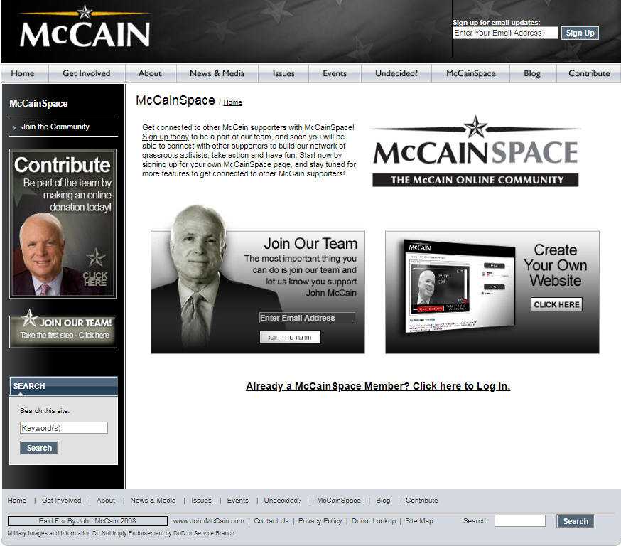
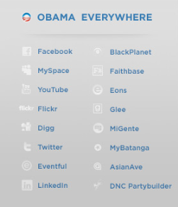
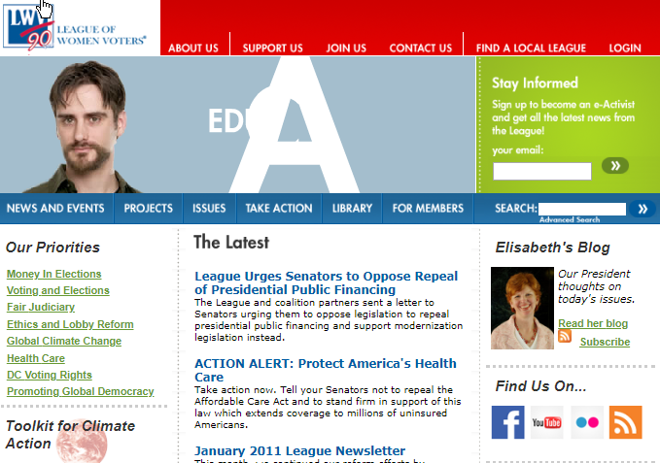
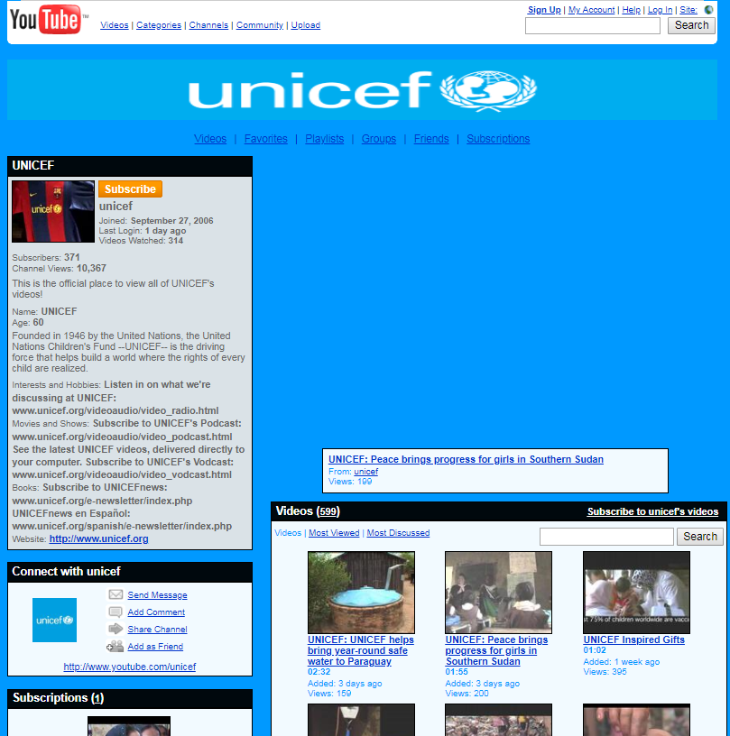
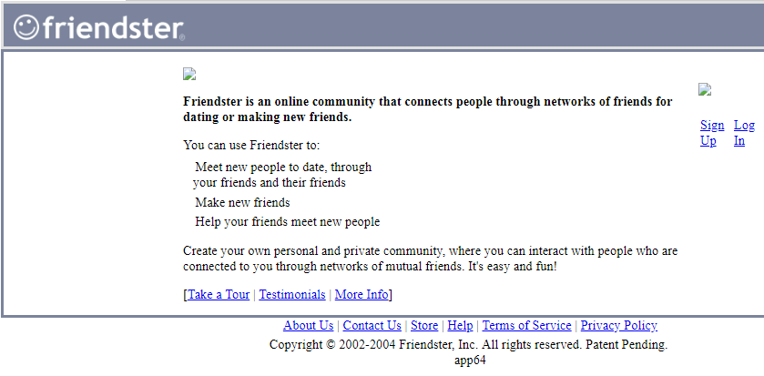
Notes:
Content shared via social media is just one of the many digital objects in our many collections. Because we value all formats for the expression of content, we recognize the need to archive social media and see potential in future research use. Moving forward as a library requires collection of social media.
Here are a few examples:
Web archiving social media
Our web archiving program began in 2000, long before many social media platforms came about. As the program has matured, new social media platforms emerged, smf we began collecting select social media content within the web archiving program. These are typically social media accounts associated with sites identified for collection in event-and thematic archives. So for instance, if we are archiving an organization’s website, we also attempt to archive that organization’s content on third party sites to create a comprehensive capture of their web presence.
Because of this, the web archives include material published via Facebook, Twitter, Pinterest, Youtube, Spotify, and Friendster. From myspace to McCain space.
Some candidates and organizations ONLY have Facebook pages – for them, Facebook has replaced use of traditional websites. In once case, a candidate running for office had a twitter feed as his “campaign site” – nothing else. To properly document elections, we must try to acquire this content.
Social media archiving is a challenge however, content behind logins is difficult to capture. The archival crawlers we use for web archiving have a difficult time keeping up with the technology used by social media companies. There are specialized tools and we are investing alternative options to improve results.
When Youtube began in 2005, we started adding content to our web archives. We estimate that 30-35% of our 1.5 petabytes of webarchives are Youtube content. Note: We’ve preserved this, but access to it remains a challenge as our access tools don’t easily display youtube videos. Further exploration into alternative access tools is required.
Twitter Archive
In 2010, the Library announced the acquisition of the entire archive of public tweets, beginning with the first tweets in 2006 through 2010, and continuing with all public tweets going forward.
The Library now has a secure collection of tweet text, documenting the first 12 years (2006-2017) of this dynamic communications channel—its emergence, its applications and its evolution.
In 2017, the Library announced a change in collection practices which ended this collection of public tweets.
The Library regularly reviews its collections practices to account for environmental shifts, diversity of collections and topics, cost effectiveness, use of collections and other factors. This change results from such a review.
Some important details:
The Library will continue to preserve and secure its collection of tweet text (through the web archives)
The Twitter collection will remain embargoed until access issues can be resolved in a cost-effective and sustainable manner.
The Library does not generally acquire all content published on a particular platform. Instead, we collect selectively according to our collection policies. Following that model, as we do for all other platforms, the Library is exploring how it will collect additional tweets selectively.
For more information http://blogs.loc.gov/loc/2017/12/update-on-the-twitter-archive-at-the-library-of-congress-2/
Images: Screenshots from:
http://webarchive.loc.gov/all/20070704184930/http://www.myspace.com/mittromney
http://webarchive.loc.gov/all/20080507183213/http://www.barackobama.com/index.php
http://webarchive.loc.gov/all/20080402223702/http://www.johnmccain.com/Connecting/
http://webarchive.loc.gov/onsite/20110209091946/http://www.lwv.org//AM/Template.cfm?Section=&WebsiteKey=
http://webarchive.loc.gov/all/20071118185505/http://www.youtube.com/user/unicef
http://webarchive.loc.gov/all/20040114034210/http://www.friendster.com/index.jsp

Slide 6
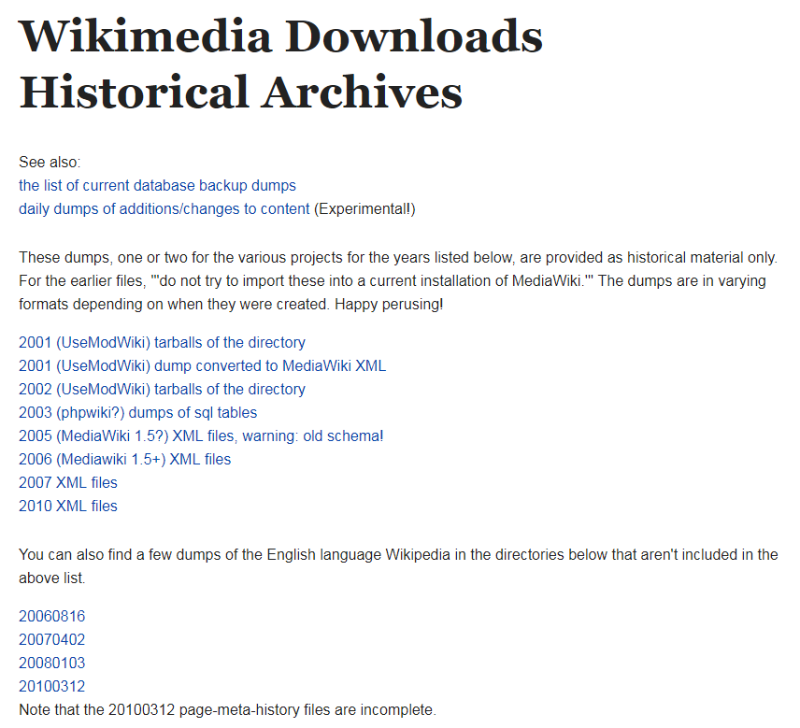
Notes:
Wikipedia collecting
The Library has collected Wikipedia in its web archives and more recently, as a dataset.
This work follows from an element in The Library of Congress Digital Collecting Plan: “Expand collecting of appropriate datasets and other large units of content”. For FY2018, the Library will“On a pilot basis, acquire sample large sets of content for the purpose of providing bulk download and text mining capabilities to the Library’s users”.
Wikipedia has been identified as a foundational exemplar for standardizing digital acquisition processes at the Library.
The goals of this project are to
Download, process, and make available all English-language Wikipedia content. Document workflows for end-to-end processes for acquiring and providing public access to Wikipedia assets. Develop plan for subsequent acquisitions of non-English-language Wikipedia content. Develop standard operating procedures for annual acquisitions of all Wikipedia content.
Independently, Wikipedia was also interested in improving link rot of citations in its articles, so began automatically linking to Library of Congress web archive content (as well as other web archives) where we have captured pages that are cited in Wikipedia articles. The result is driving more referral traffic to the Library’s web archive collections, with minimal effort by the Library.
Image: https://dumps.wikimedia.org/archive/

Slide 7
Notes:
Lessons Learned: Scale of Collecting
How do you plan and scale infrastructure to meet the sometimes exponential growth of a given content stream?
There’s no way we as LC or any one institution can capture it all. Decisions are needed about what to preserve. Those decisions are made by institutions based on collecting scope and policies, and often determined by legal requirements or limitations.
Preserving entire streams probably isn’t realistic for most libraries, though has happened in some cases (an example: Geocities and Internet Archive https://archive.org/web/geocities.php).
There are challenges to preserving ingesting and preserving entire streams of content. These platforms have massive quantities of data, being produced faster than we can acquire it.
But even preserving selectively, Libraries have to plan for tremendous growth – there are storage considerations and processing needs that go beyond just storing the data and making it accessible. Description at scale is a challenge.
We are just beginning to understand and anticipate researcher needs when it comes to use of large data sets; we need tools to process digital collections in new ways. Tools are also needed to provide access and to allow for search and discovery.
Just as we think we have a handle on one stream, a new one appears.
We also can’t fully anticipate the next generation of social media platforms: what they will look like, how they will be adopted by users, and what value they will have for future research. In the meantime, we monitor new platform usage appear in our web archives and monitor such trend reports as those published by Pew: http://www.pewinternet.org/2018/03/01/social-media-use-in-2018/
Images:
Illustration: Copyright of digitalbevaring.dk and shared under a CC BY 2.5 Denmark licence https://creativecommons.org/licenses/by/2.5/dk/deed.en_GB
Chart: Growth of Library of Congress Web Archives, 2010-2017

Slide 8
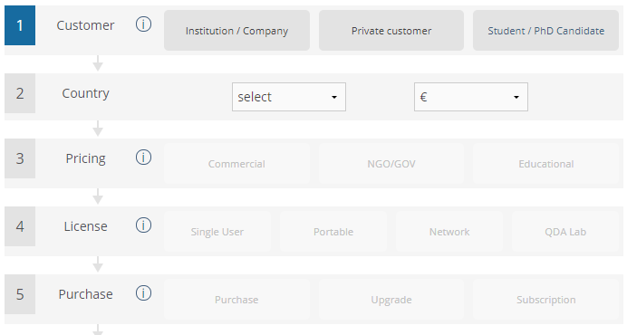
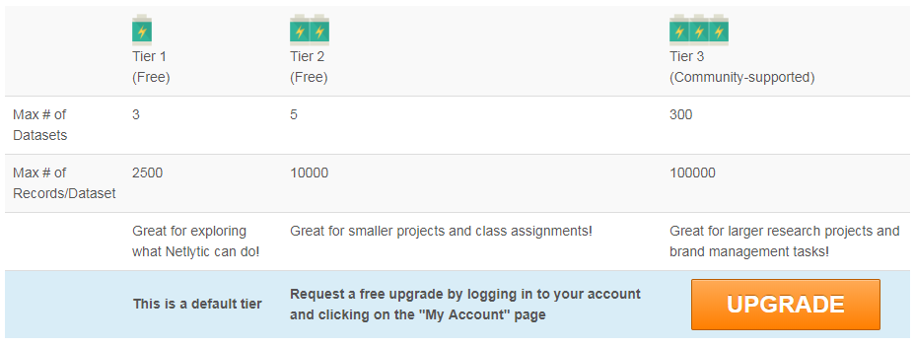
Notes:
Economic value of social media content
Selling the content (or access to it) managed by social media companies has become an important part of many social media business models. This has implications for libraries managing, securing, and serving large datasets of social media content.
Social media datasets are worth a lot of money.
Social media companies make profits on repackaging or providing access to the data.
The companies providing access have money to invest in search and discovery tools – Libraries can’t compete.
Along with having money to invest in search and discovery tools, companies that are creating and selling social media content have knowledge of and access to their proprietary systems.
“Collecting and analyzing millions of data points from social media require a lot of computing power.” – from https://netlytic.org/home/?page_id=10834
There is value for libraries is in collecting and ensuring long-term preservation. Researchers in 50, 100 years will be happy we’ve preserved this content. The tools will improve, the computing power that we have access too hopefully will as well.
Images: Screenshots from social media data companies

Slide 9
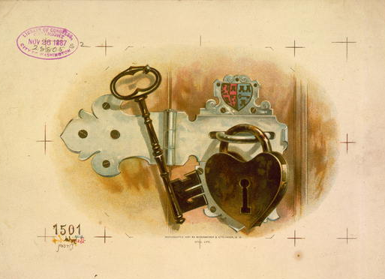
Notes:
Lessons Learned: User Privacy /Content fixity
For those considering acquiring social media, how willing are you to allow the content to be changed and by whom?
Library has a role in ensuring that content is “as it was” when we archived it.
In one recent case, having the same content in multiple archives dissuaded recent claims that the Internet Archive was “hacked.”
Some preservation tools build in features that support fixity. For example, one of the unique features of the tool Social Feed manager is that they record their interactions with social media APIs in WARC files.
What legal and ethical obligations do libraries and others preserving social media content have to the original authors of the content?
How to we protect the rights of users who have deleted content from the very platforms that we are archiving?
Legal obligations are different in Europe than the U.S.
Privacy rules in other countries stronger than in U.S.
Right to be forgotten laws have been around a long time and sometimes affect access to preserved content in other countries http://sro.sussex.ac.uk/61204/9/reset-807.pdf
The effect of GDPR is still emerging how it affects social media collecting and digital preservation in general. National Libraries are monitoring and discussing internally if and how their preservation programs are affected.
Here in the U.S., Documenting The Now is a project that is exploring ethical archiving https://www.docnow.io/. A key focus is:
Honoring user intent
Honoring rights of content creators
Additional resources:
Justin Littman’s presentation https://www.slideshare.net/JustinLittman/presentation-at-national-forum-on-ethics-archiving-the-web-march-23-2018 at the Ethics & Archiving the Web conference, and their Social media research ethical and privacy guidelines (https://gwu-libraries.github.io/sfm-ui/resources/social_media_research_ethical_and_privacy_guidelines.pdf) and Building Social Media Archives: Collection Development Guidelines (https://gwu-libraries.github.io/sfm-ui/resources/guidelines)
Image: Still life, c1887 -- cph 3g05657 //hdl.loc.gov/loc.pnp/cph.3g05657

Slide 10
Institution as Social Media User: Lessons Learned from the National Archives and Records Administration and the Library of Congress
Notes:
NARA leads part two.

Slide 11
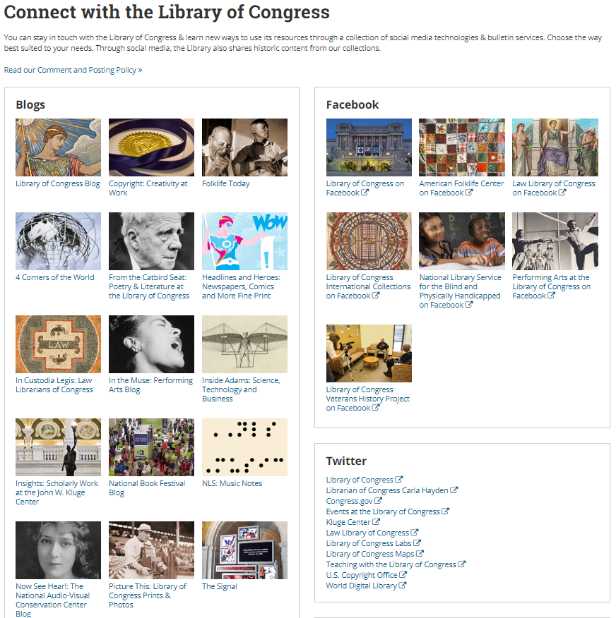
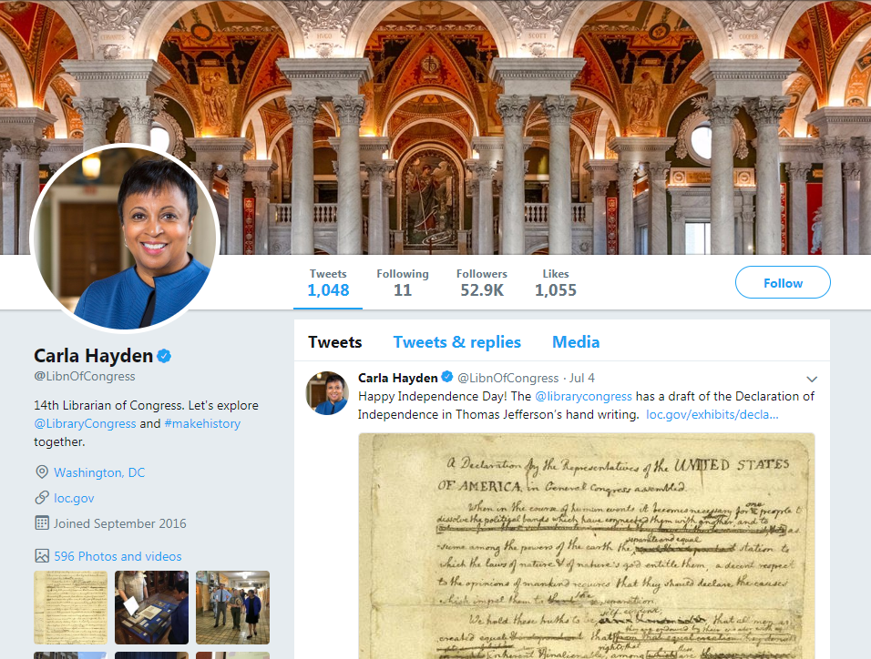
Notes:
The Library of Congress uses social media to connect
Users can connect with the Library through a variety of social media platforms.
This is evident when viewing our connect page https://www.loc.gov/connect/
We are everywhere, and expanding: Blogs, Facebook, Twitter, Instagram, Flickr, Pinterest – our latest addition is Medium. We have video channels and podcasts.
In 2016, Dr. Carla Hayden launched her own twitter account.
Images: Screenshots of https://www.loc.gov/connect/ and https://twitter.com/libnofcongress

Slide 12
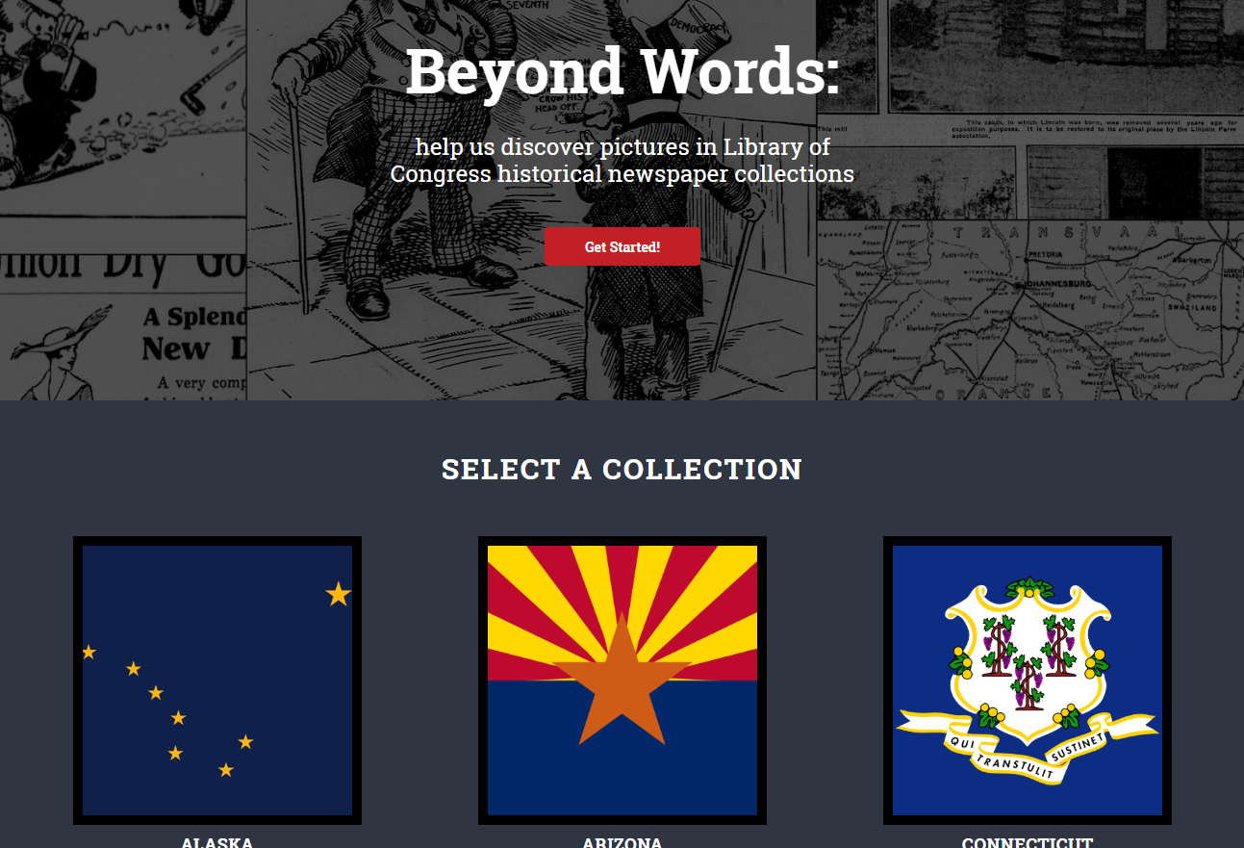
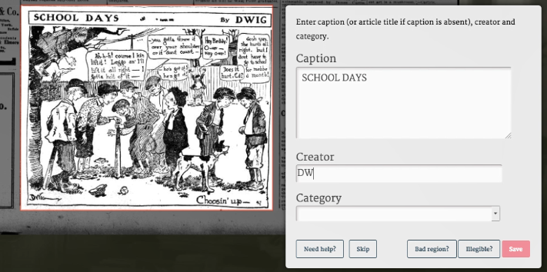
Notes:
Library of Congress social media use – case studies
Beyond Words/Chronicling America
Experimental project through labs.loc.gov to test out new crowdsourcing methods and applications beyond the Flickr project.
Users invited to help identify illustrations and provide captions in WWI-era newspapers. The application also generates public domain image galleries for scholarship and creative play.
Identified and captioned illustration viewed in a public gallery. All contributions released into the public domain and users are free to use this data set in any way they want, including sharing through other social media platforms.
Image: Screenshot of http://beyondwords.labs.loc.gov/#/

Slide 13
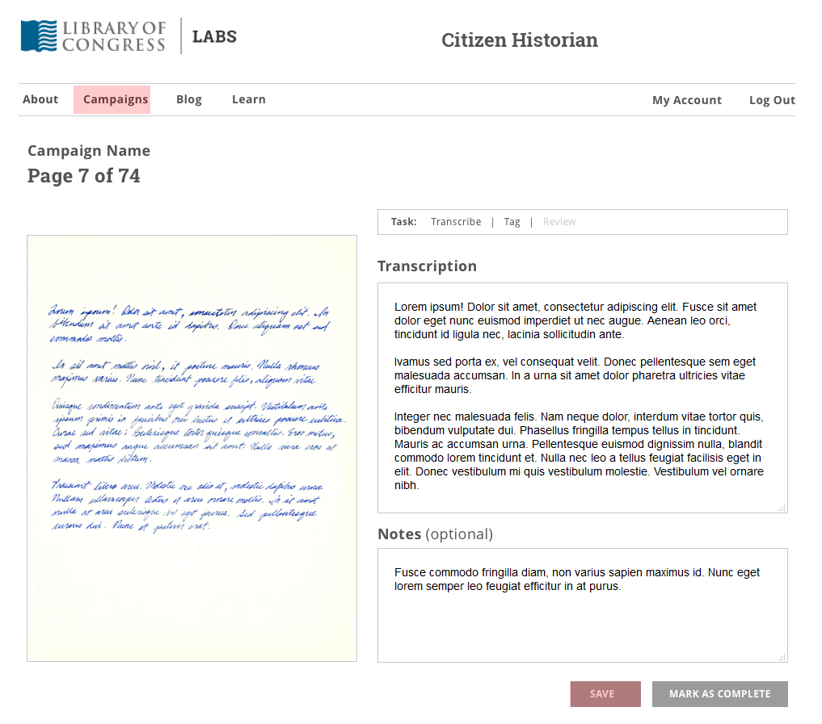
Notes:
Crowdsourced Transcription Platform
These are some wireframes for a platform we’re working on that will invite users to transcribe and tag text in images
This will increase the usability and findability of our digitized historic texts. Think letters between early poets or scientist’s lab notebooks.
We’re developing it as an open source project. So if you’re interested in contributing or seeing if this solution might be a fit for a need you have, check it out on the Library of Congress’s GitHub page.
Launching in the fall
Application is both a consumer of social media (we will use the Library’s social media to engage with the community and drive engagement) and a producer (people will use a forthcoming forum site to engage with material and each other).
Image: In-house development wireframes http://ec2-52-91-211-3.compute-1.amazonaws.com/#

Slide 14
Credits
Authors, Library of Congress
Moryma Aydelott, Program Planning Specialist
David Brunton, Chief of Repository Development
Abbie Grotke, Lead of Web Archiving Team
Nicole Marcou, Confidential Assistant to the Principal Deputy Librarian
Michelle Rago, Supervisory Digital Content Strategist
Steve Short, Program Planning Specialist
J. Mark Sweeney, Principle Deputy Librarian of Congress
Kate Zwaard, Director of Digital Strategy
Image credits
Highsmith, Carol M., [Exterior view. View of the roof, dome, and cupola. Library of Congress Thomas Jefferson Building, Washington, D.C.] https://www.loc.gov/item/2007684218/
Highsmith, Carol M., National Archives Building, Washington, DC https://www.loc.gov/item/2011630755/
Search results from https://www.loc.gov/collections/?st=grid
Social Media in the Library of Congress Web Archives:
http://webarchive.loc.gov/all/20070704184930/http://www.myspace.com/mittromney
http://webarchive.loc.gov/all/20080507183213/http://www.barackobama.com/index.php
http://webarchive.loc.gov/all/20080402223702/http://www.johnmccain.com/Connecting/
http://webarchive.loc.gov/onsite/20110209091946/http://www.lwv.org//AM/Template.cfm?Section=&WebsiteKey=
http://webarchive.loc.gov/all/20071118185505/http://www.youtube.com/user/unicef
http://webarchive.loc.gov/all/20040114034210/http://www.friendster.com/index.jsp
Wikimedia Downloads and Historical Archives https://dumps.wikimedia.org/archive/
Illustration copyright of digitalbevaring.dk and shared under a CC BY 2.5 Denmark licence https://creativecommons.org/licenses/by/2.5/dk/deed.en_GB
Growth of Library of Congress Web Archives, 2010-2017
Social media data company site subscription modesl https://discovertext.com/, https://www.maxqda.com/, https://netlytic.org
Still life (tobacco label) https://www.loc.gov/item/98505082/
Library of Congress Connect https://www.loc.gov/connect/ and Librarian’s Twitter account https://twitter.com/libnofcongress
Beyond Words http://beyondwords.labs.loc.gov/#/
Crowdsourced Transcription Platform Beta (in development)

