Slide 1
IFLA at the Internet Governance Forum
Stephen Wyber, Manager, Policy and Advocacy, IFLA
14 December 2017, Webinar

Slide 2
Libraries and the Internet
Different form, same goal?
A growing dependency?
Delivering Development and Access to Information

Slide 3
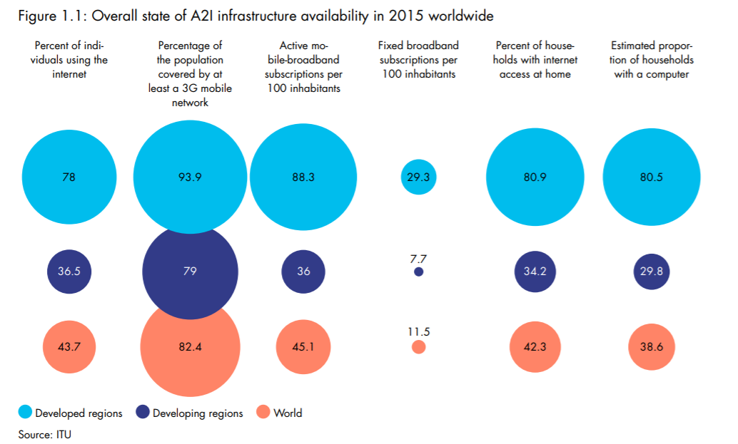

Slide 4
Who?
Government
Business
Internet Service Providers
Non-Governmental Organisations
Users

Slide 5
What?
Business and Trade
Cables and Content
Security and Safety
Social issues
Governance

Slide 6
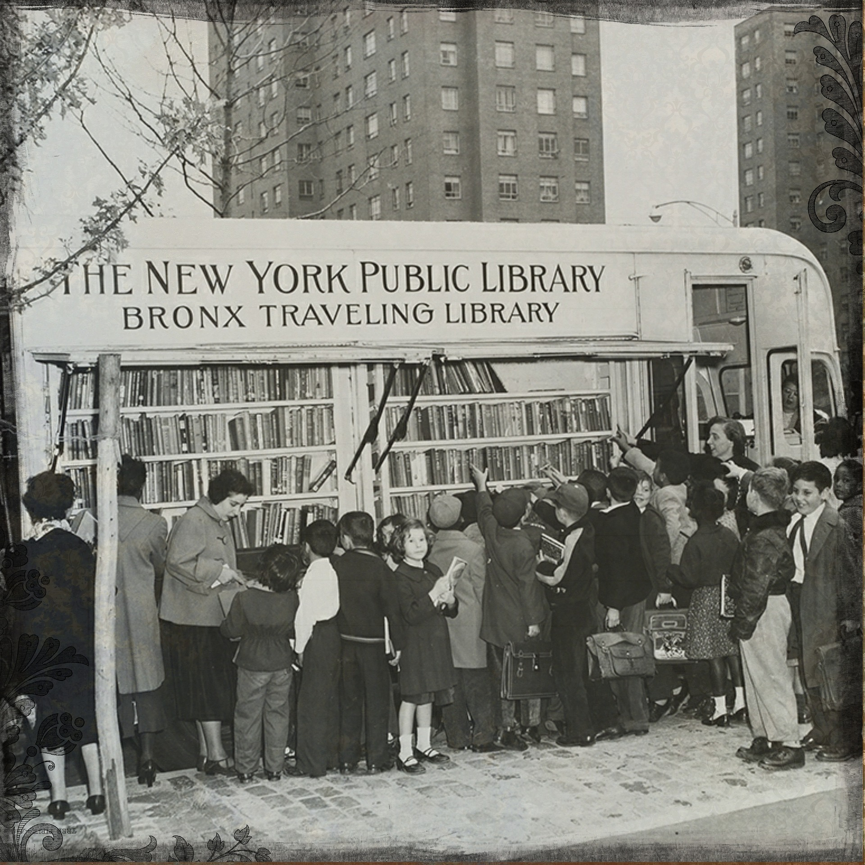
Connected Libraries and Communities
Open Internet Infrastructure
Empowered Users

Slide 7
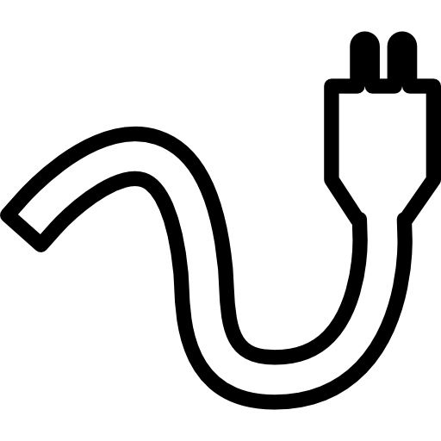
Connected Libraries and Communities
Growing Dependence on the Internet
The Cost of Connection is Falling
Principles on Public Access

Slide 8
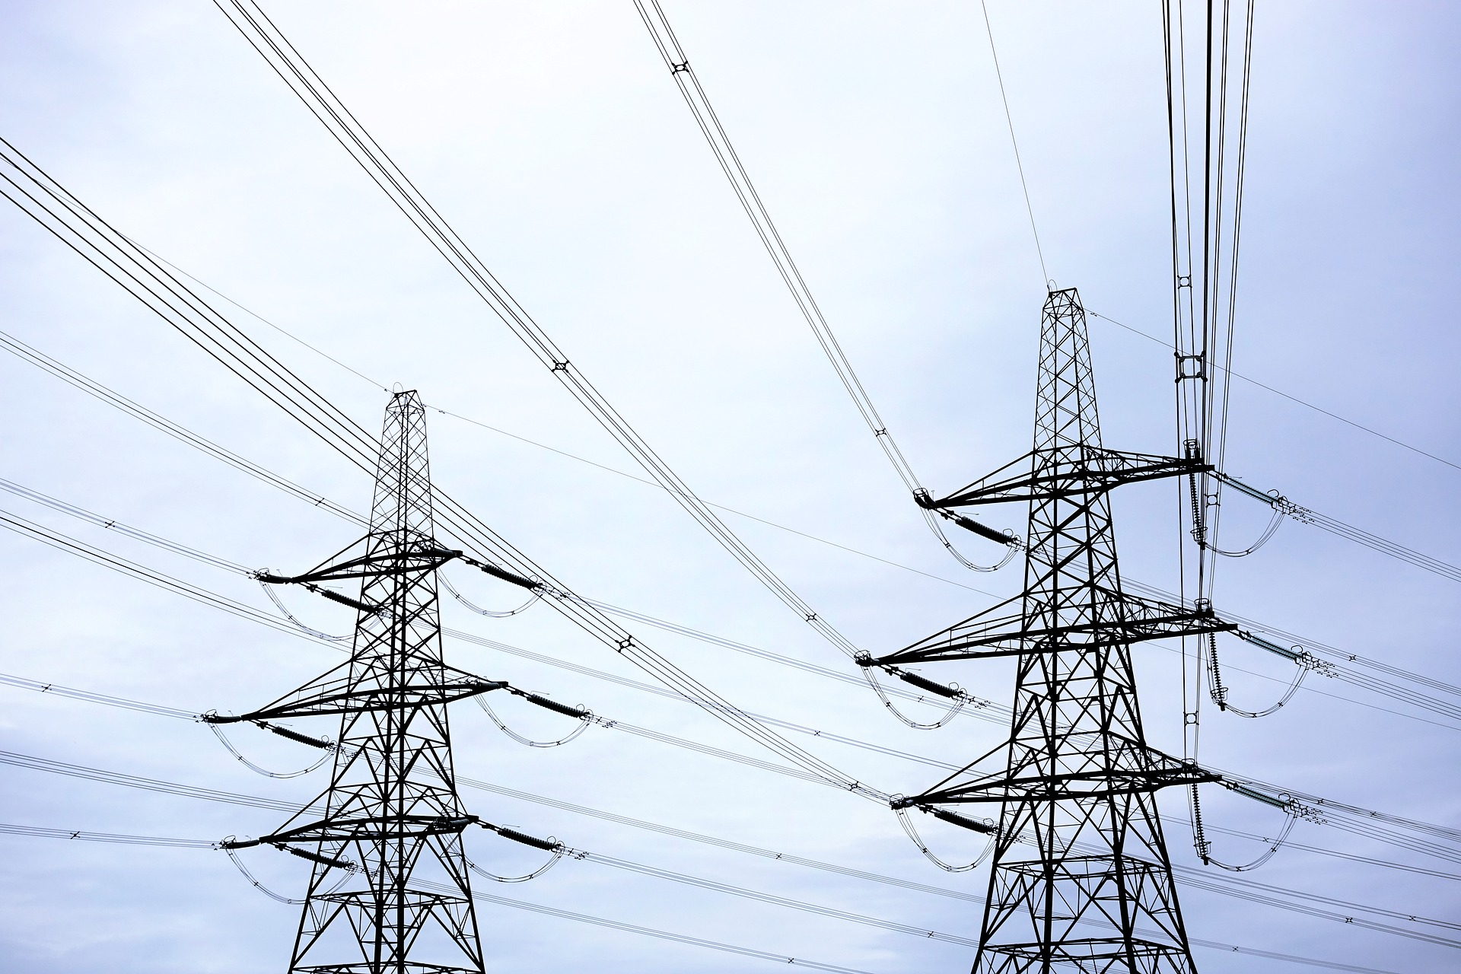
Open Internet Infrastructure
Protect Net Neutrality
Keep the Internet On
Promote Free Speech
Copyright

Slide 9
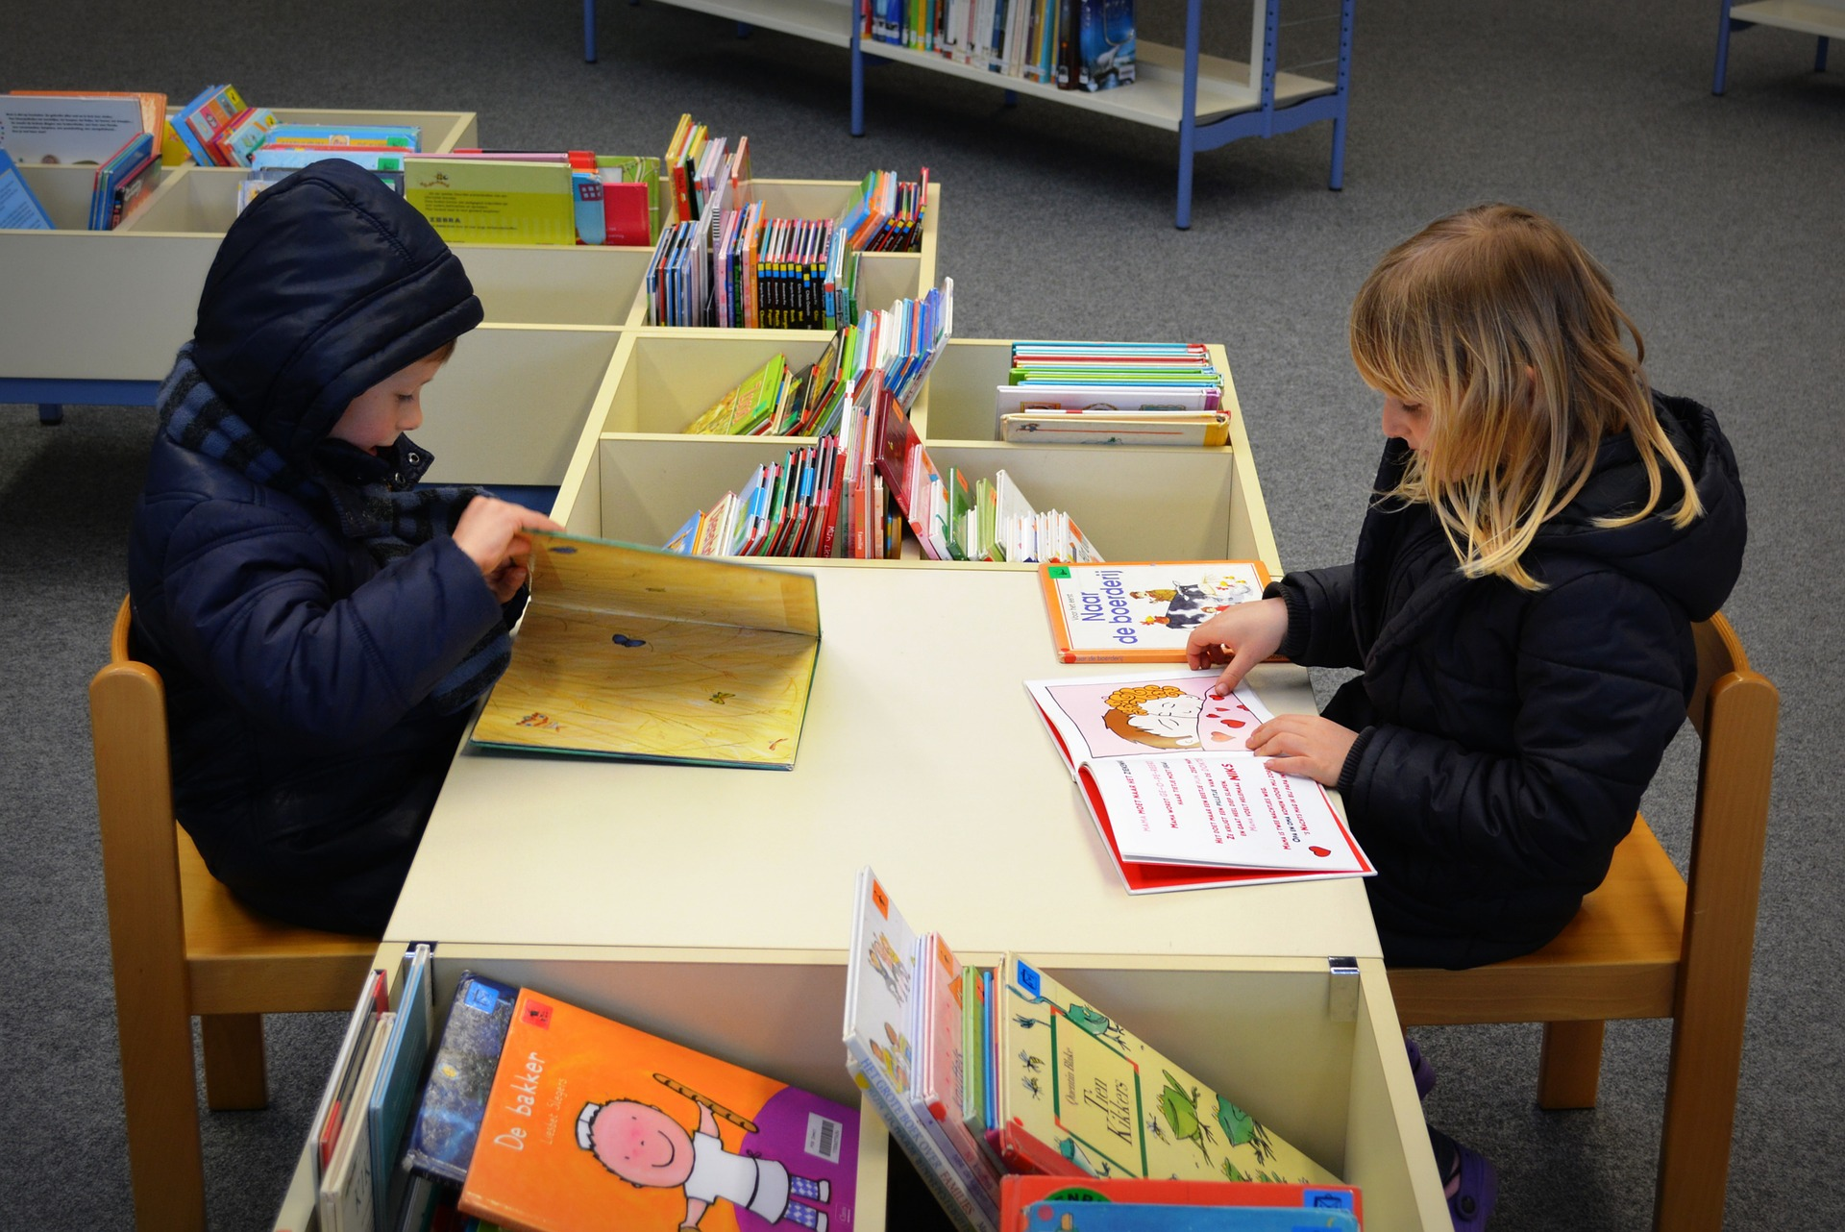
Empowered Users
From basic IT skills…
…to higher level information literacy

Slide 10
IFLA at IGF 2017
Regional IGFs
Dynamic Coalition on Public Access
Main Dynamic Coalitions Session
Sessions on Internet Indicators, Digital Literacy, Public Access, Access to Knowledge and Digital Preservation

Slide 11
Follow us!
Participate Online! https://www.intgovforum.org/multilingual/content/igf-2017-online-participation-registration
Twitter: @IFLA, @dswyber
Facebook: https://www.facebook.com/IFLA-International-Federation-of-Library-Associations-and-Institutions-115229368506017/?ref=br_rs
Blogs: https://blogs.ifla.org/lpa/
Questions?

