Slide 1
Libraries as Publishing Partners
Promoting best practices in open access journals
Suzanne Cady Stapleton George A. Smathers Libraries
University of Florida
IFLA Special Interest Group on
Library Publishing Mid-Term Meeting
Dublin, Ireland
February 28, 2019

Slide 2
Why are the libraries publishing?
Publishing by academic libraries is emerging as a viable means to create open access to scholarly research.
Library publishing supports development of a
“New Fair Deal” where academic libraries creatively decommodify knowledge by directly subsidizing library publishing cooperatives.” (Ghamandi, 2018)

Slide 3
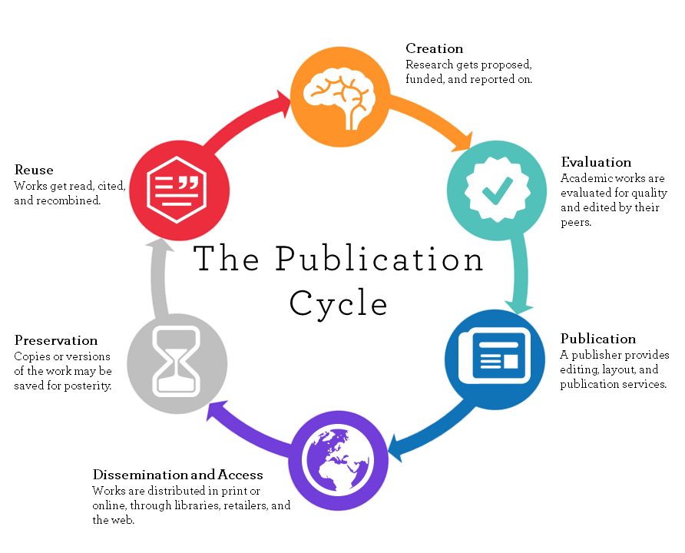
Publishing aligns with the library mission
The Libraries ignite curiosity, serve as the locus of knowledge management, and promote intellectual exchange within our diverse global learning community.
The Smathers Libraries collaborate with UF faculty, students and staff, as well as the University’s collaborators and constituents, to facilitate knowledge creation that contributes to UF’s standing as a preeminent public research university.
UF Smathers Libraries Strategic Directions, 2018
Image from the University of Winnipeg, CC By

Slide 4
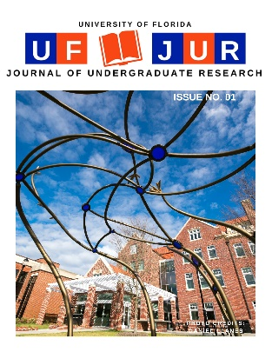
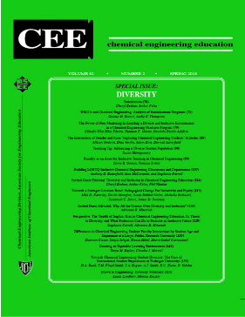
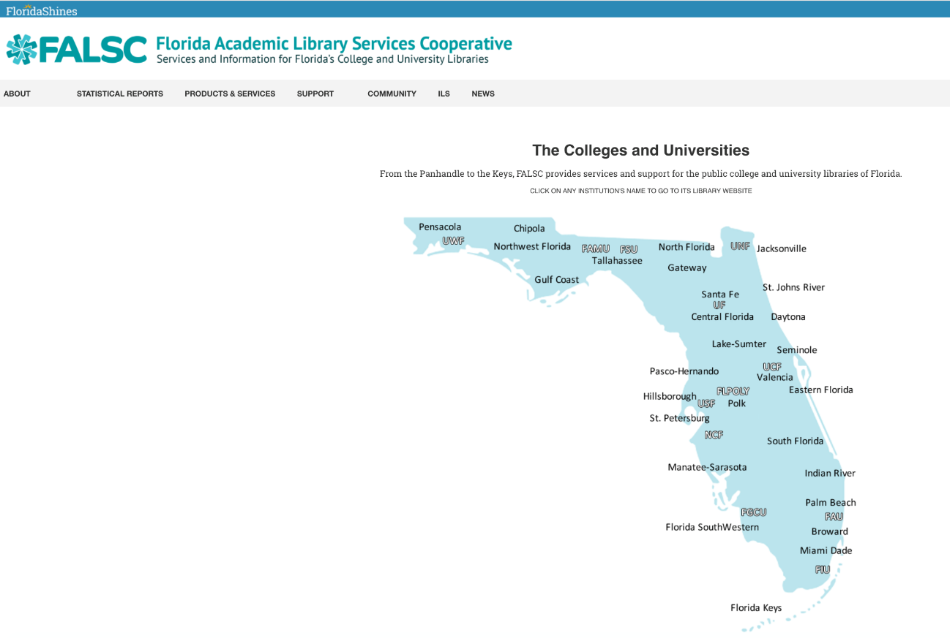
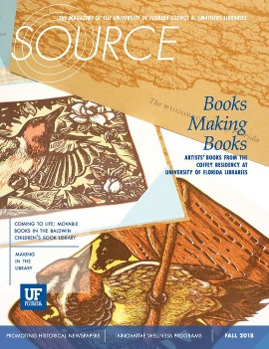
UF Journal Publishing Program
Journals.fcla.edu

Slide 5
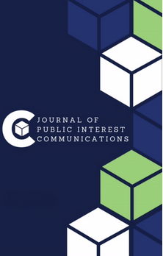
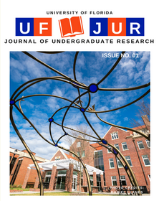
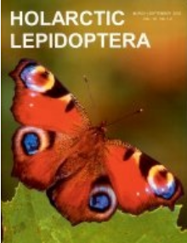
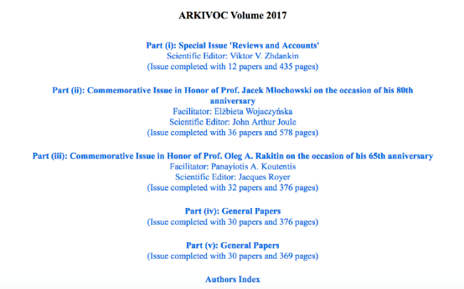
Successes & Lessons Learned
Arkivoc

Slide 6
Best Practices: Listen to unique user needs

Slide 7
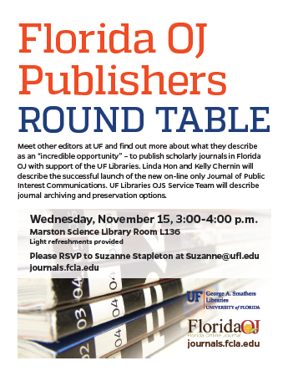
Best Practices: Use opportunities to educate

Slide 8
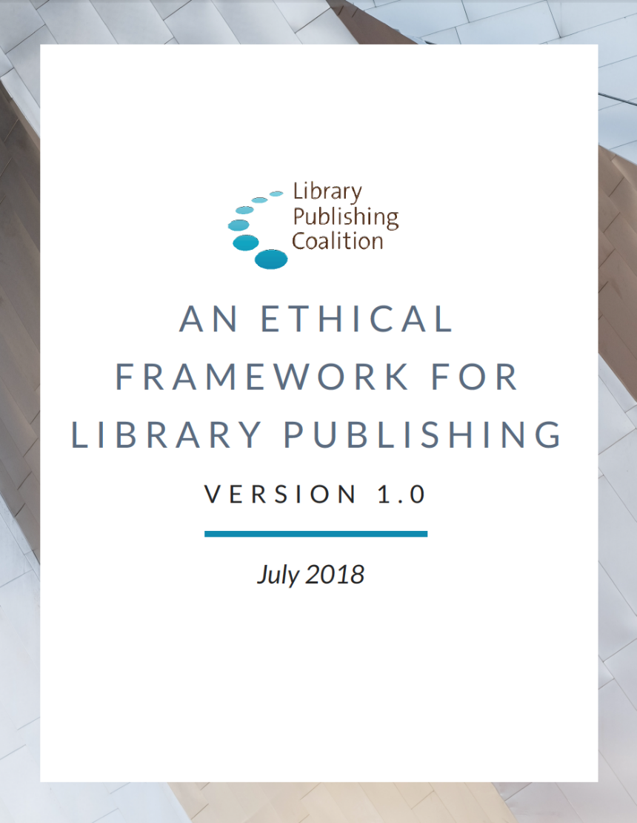
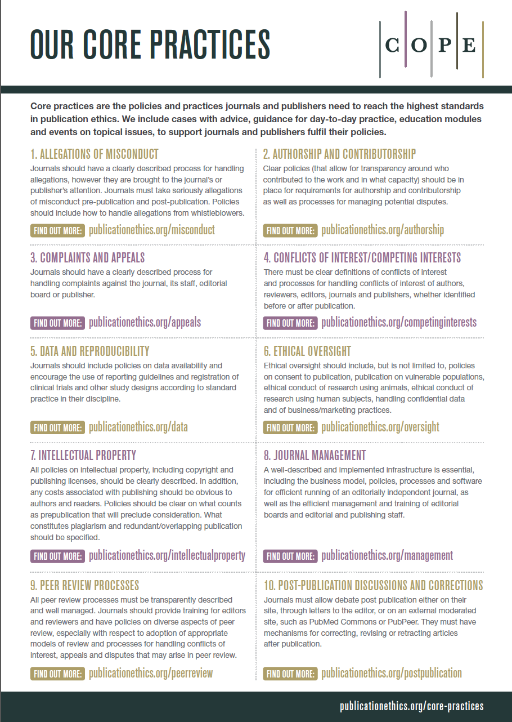
Best Practices: Promote ethical standards
Boczar et al, 2018
Committee on Publication Ethics, 2019

Slide 9
Supporting the Library Journal Publishing Program
Service Team
Team leader
Scholarly Communications Librarian
Institutional Repository Manager
Digital Support Services Chair
Liaison Librarian

Slide 10
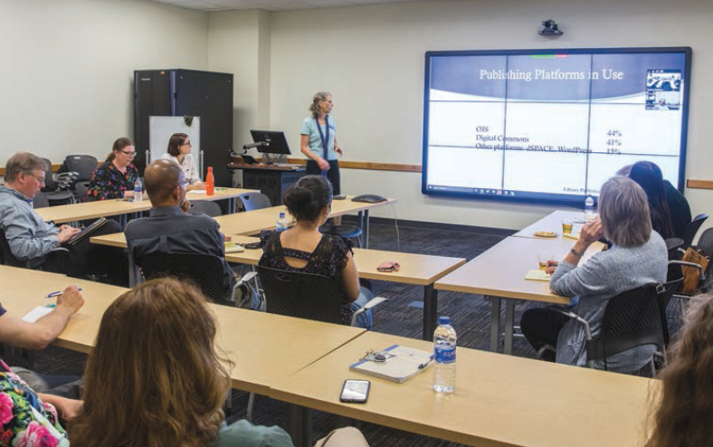
Supporting the Library Journal Publishing Program
“Train the Trainer”
Training Liaison Librarians
Checklist for Liaison Librarians
Outreach Events & Materials
Publishers Round Table Series
National Peer Review Week
Publishing LibGuide
Open Access Mythbusters
Photo: UF Smathers Libraries Strategic Directions, 2018

Slide 11
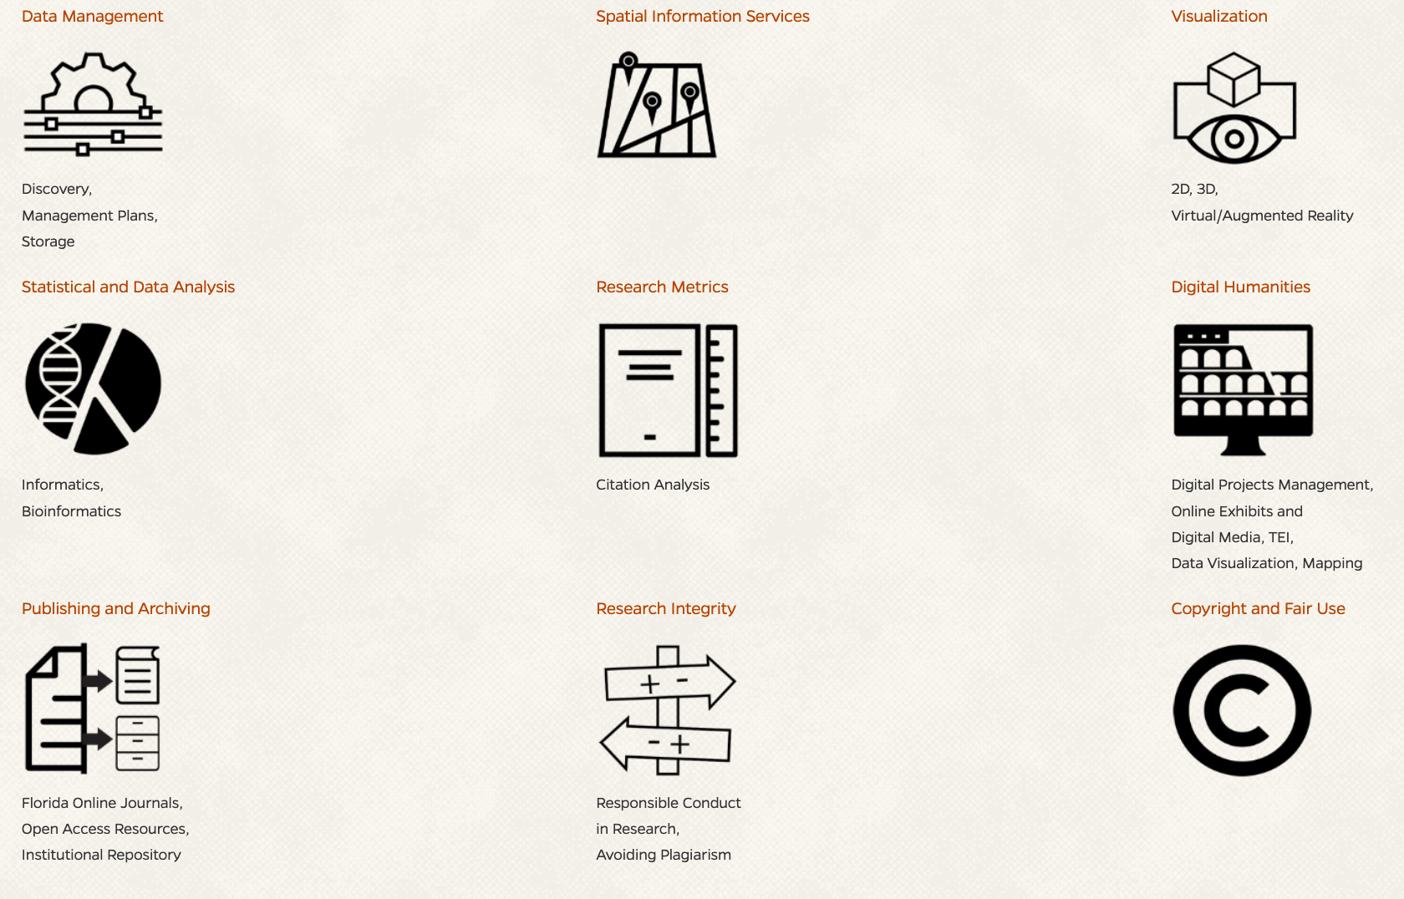
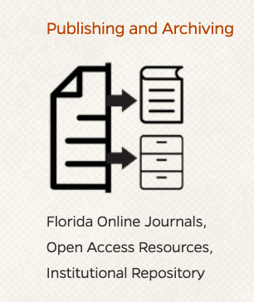
Promoting the Library Journal Publishing Program
http://arcs.uflib.ufl.edu/

Slide 12
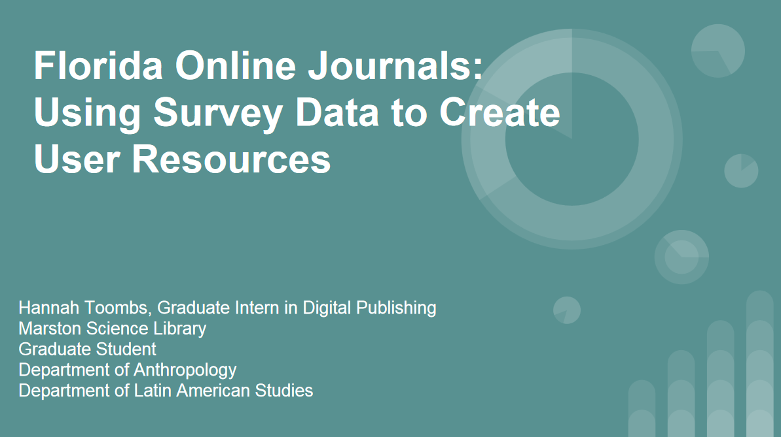
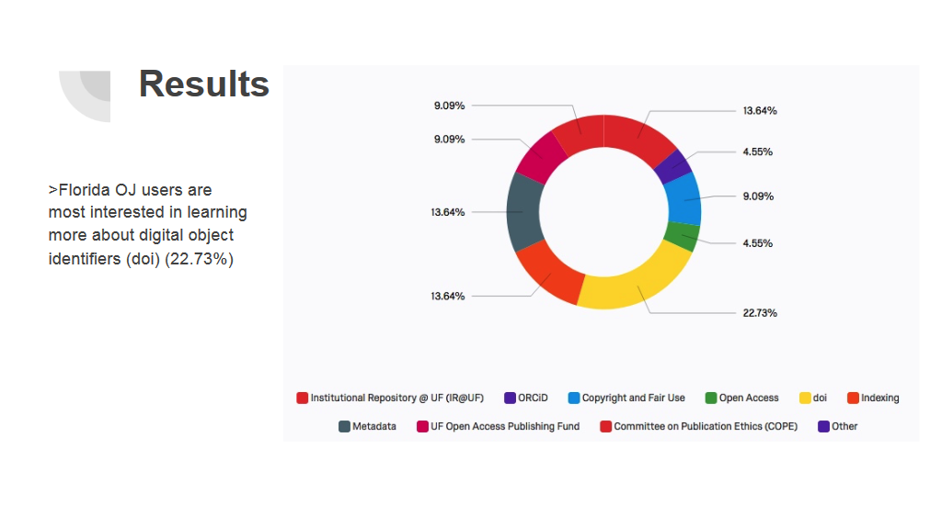
Summary
Customize publishing service
Annual user assessment
Iterative evolution
Toombs, 2018

Slide 13
Next Steps
Consolidation into new department
Growth in dedicated personnel
Increased collaboration with UF Press
Branding
Evolution of library publishing standards

Slide 14
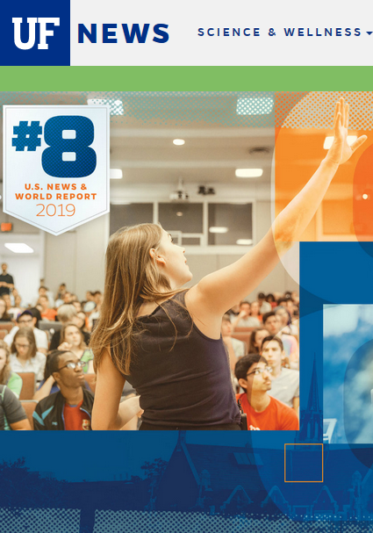
Testimony of success
“I am writing this e-mail to, first, express my gratitude to the staff of the library. The circulation of the journals and visibility through Google Scholar has already greatly improved.
I think that all journal editors at the [campus unit] should take note of this opportunity, which is incredible, considering the cost or/and strings attached if one were to engage in similar cooperative agreement with a commercial publisher.”
Comments from a Florida Online Journal Editor
Image: “UF rises to No. 8 in U.S. News”, 9/10/2018

Slide 15
References and Credits
Boczar, Jason; Collins, Nina; Cummings-Sauls, Rebel; Fishel, Terri; Horton, Valerie; Inefuku, Harrison W.;
Melton, Sarah; Neds-Fox, Joshua; Robertson, Wendy C.; Roh, Charlotte; Schlosser, Melanie; Sipovic, Jaclyn;
Thomas, Camille; and Westin, Monica, "An Ethical Framework for Library Publishing" (2018). Ethical Framework
for Library Publishing. Paper 1. http://dx.doi.org/10.5703/1288284316777
Committee on Publication Ethics. 2019. Committee on Publication Ethics Core Practices. https://publicationethics.org/core-practices
George A. Smathers Libraries Strategic Directions December 2018. http://ufdc.ufl.edu/l/IR00004144/00005/pdf
Ghamandi, D. S. 2018. Liberation through Cooperation: How library publishing can save scholarly journals from Neoliberalism. J of Librarianship and Scholarly Communication, 6(Special Issue: The Role of Scholarly Communication in a Democratic Society), eP2223. https://doi.org/10.7710/2162-3309.2223
Publishing lifecycle [image] Univ of Winnipeg, https://library.uwinnipeg.ca/scholarly-communication/index.html
Toombs, H. 2018. Florida Online Journals: Using Survey Data to Create User Resources [slideset] http://ufdc.ufl.edu/IR00010269/00001

Slide 16
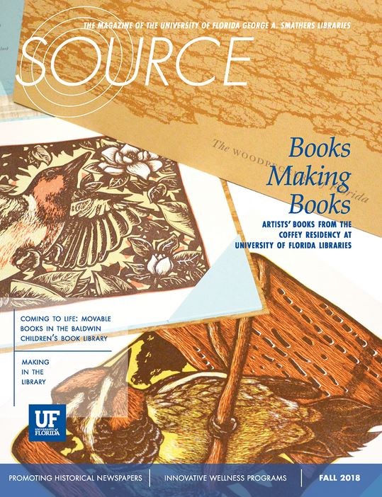
Questions?
Thanks to my journal publishing team: Laurie Taylor, Chelsea Dinsmore, Christy Shorey, Perry Collins, Wilhelmina Randtke. And thanks to all of our publishing partners!
Thank you!
suzanne@ufl.edu
#UFstapleton

