Slide 1
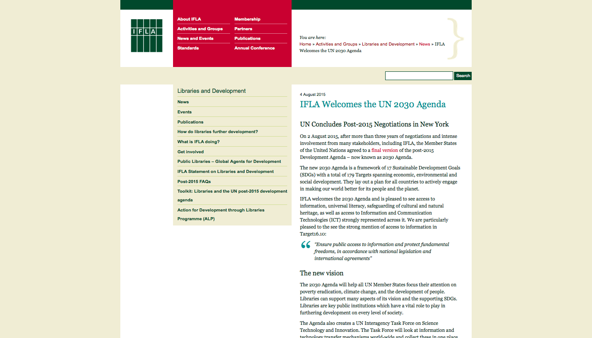
https://sustainabledevelopment.un.org/content/documents/7891TRANSFORMING%20OUR%20WORLD.pdf
Notes:
And then on the afternoon of August 4th…

Slide 2
The UN 2030 Agenda
Preamble
Declaration
Sustainable Development Goals
Means of Implementation and Global Partnership
Follow-up and Review
https://sustainabledevelopment.un.org
Notes:
This is the 2030 Agenda (29 pages)

Slide 3
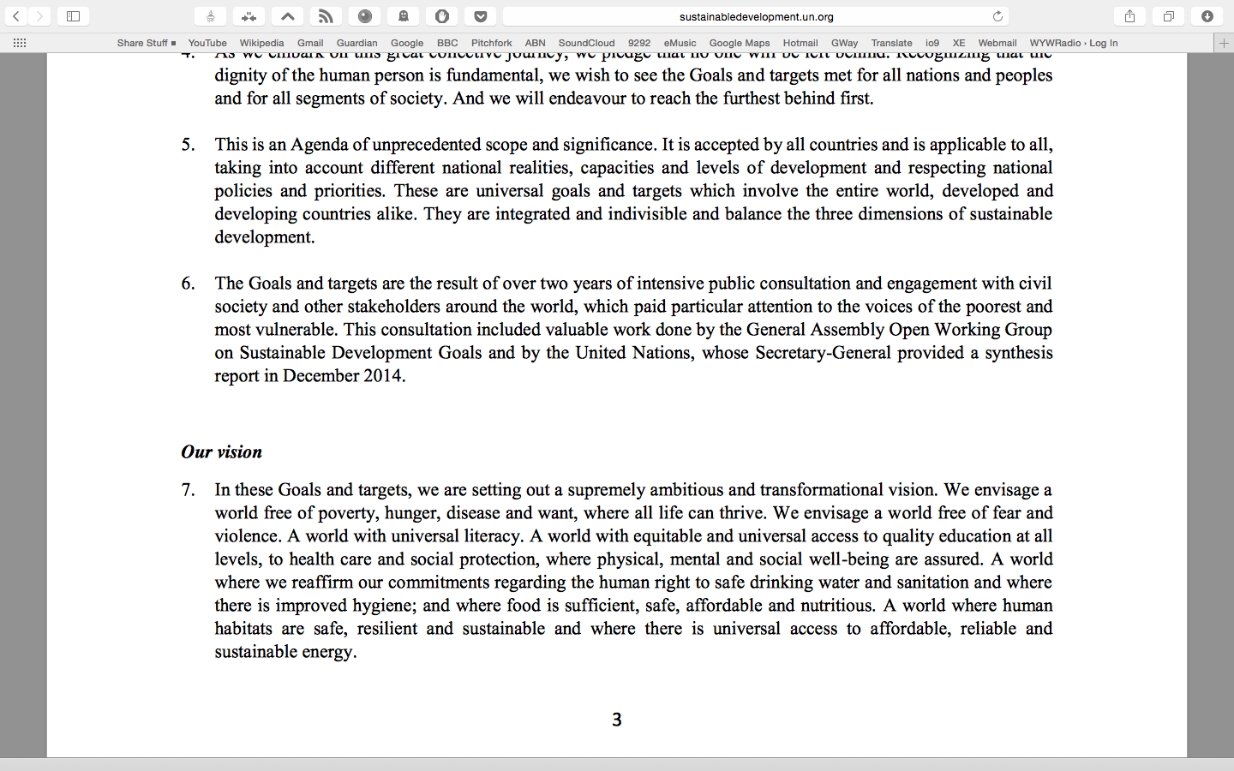
Notes:
Talk about what we were advocating for in the last week - the inclusion of universal literacy – thanks to Lyon Declaration signatories’ work we got it in!

Slide 4
Sustainable Development Goals
Goal 1. End poverty in all its forms everywhere
Goal 2. End hunger, achieve food security and improved nutrition, and promote sustainable agriculture
Goal 3. Ensure healthy lives and promote well-being for all at all ages
Goal 4. Ensure inclusive and equitable quality education and promote life-long learning opportunities for all
Goal 5. Achieve gender equality and empower all women and girls
Goal 6. Ensure availability and sustainable management of water and sanitation for all
Goal 7. Ensure access to affordable, reliable, sustainable, and modern energy for all
Goal 8. Promote sustained, inclusive and sustainable economic growth, full and productive employment and decent work for all
Goal 9. Build resilient infrastructure, promote inclusive and sustainable industrialization and foster innovation
Goal 10. Reduce inequality within and among countries
Goal 11. Make cities and human settlements inclusive, safe, resilient and sustainable
Goal 12. Ensure sustainable consumption and production patterns
Goal 13. Take urgent action to combat climate change and its impacts*
Goal 14. Conserve and sustainably use the oceans, seas and marine resources for sustainable development
Goal 15. Protect, restore and promote sustainable use of terrestrial ecosystems, sustainably manage forests, combat desertification, and halt and reverse land degradation and halt biodiversity loss
Goal 16. Promote peaceful and inclusive societies for sustainable development, provide access to justice for all and build effective, accountable and inclusive institutions at all levels
Goal 17. Strengthen the means of implementation and revitalize the global partnership for sustainable development
https://sustainabledevelopment.un.org
Notes:
Run quickly through the goals at a high level
Goals and Targets
17 Goals (w/MDG comparison)
169 Targets
Explain that there more than the MDGs because of the consultative way that the consultations progressed, and the ambition of the Member States

Slide 5
Selected Goals and Targets
Goal 2: End hunger, achieve food security and improved nutrition, and promote sustainable agriculture
  Target 2.3 by 2030 double the agricultural productivity and the incomes of small-scale food producers, particularly women, indigenous peoples, family farmers, pastoralists and fishers, including through secure and equal access to land, other productive resources and inputs, knowledge, financial services, markets, and opportunities for value addition and non-farm employment
Goal 3: Ensure healthy lives and promote well-being for all at all ages.
  3.1 by 2030 reduce the global maternal mortality ratio to less than 70 per 100,000 live births
Goal 4: Ensure inclusive and equitable quality education and promote life-long learning opportunities for all.
  4.6 by 2030 ensure that all youth and at least x% of adults, both men and women, achieve literacy and numeracy
Goal 5: Achieve gender equality and empower all women and girls
  5b. enhance the use of enabling technologies, in particular ICT, to promote women’s empowerment
Goal 11: Make cities and human settlements inclusive, safe, resilient and sustainable
  11.4 strengthen efforts to protect and safeguard the world’s cultural and natural heritage
Notes:
These were some of the ones we were keeping an eye on in the negotiations – we always knew libraries could play a role

Slide 6
Goal 16: Promote peaceful and inclusive societies for sustainable development, provide access to justice for all and build effective, accountable and inclusive institutions at all levels
  Target 16.10:
  “Ensure public access to information and protect fundamental freedoms, in accordance with national legislation and international agreements”
Notes:
Jewel in the crown
Talk about how all Goals and Targets are going to be implemented at national levels – we must seize the moment and get included in national development plans
Direct to the next session for more information

Slide 7
Impact of the Lyon Declaration
589 Signatories
72% library organisations, 28% outside of library sector
Development NGOs, technology sector, media
  Europe: 211 -36%
  North America: 50 – 8.5%
  South America: 73 – 13%
  Africa: 48 – 8.5%
  Asia: 94 – 17%
  International: 90 – 16%
  Industry: 5 – 1%
Lyon, Milan
Notes:
Talk through slide
Talk about how it brought new allies to our side
Talk about how it helped library representatives at national level start a conversation
Talk about how it gave visibility to our issues, and ultimately libraries, in development conversations wherever post-2015 was being discussed
Talk about how Lyon Declaration gave IFLA a mandate to take our issues to UN Member States – it gave us confidence
At the beginning we needed a piece of paper to wave in the air at the right person, at the right moment – but it turned out to be way more than that

Slide 8
What do we do next?
Learn to speak the language of development
  http://www.ifla.org/libraries-development
  www.beyondaccess.net
Familiarise yourself with the SDGs – where do you think library services can contribute?
Look at the priorities for development in your country, and assess where to pitch libraries’ role
Build cross-sector alliances with development organisations to solve problems – think outside the library community
Actively engage with policymakers to get libraries incorporated into national development plans
Notes:
Talk to slide – Summit at the end of the month

Slide 9
































































Notes:
And I’ll leave it there – some of the 589 organisations who have signed the Declaration

Slide 10
Relevant documents
IFLA (2013). Statement on Libraries and Development
http://www.ifla.org/publications/ifla-statement-on-libraries-and-development
IFLA (2014). The Lyon Declaration on Access to Information and Development
www.lyondeclaration.org
UN (2015). Transforming our world: The 2030 Agenda for sustainable development
https://sustainabledevelopment.un.org/content/documents/21252030%20Agenda%20for%20Sustainable%20Development%20web.pdf
Website: https://sustainabledevelopment.un.org/sdgs
Sustainable Development Solutions Network (SDSN) (2015). Getting started with the SDGs: A guide for stakeholders
http://unsdsn.org/wp-content/uploads/2015/12/151211-getting-started-guide-FINAL-PDF-.pdf
Beyond 2015: From policy to action toolkit (NB case studies)
http://www.beyond2015.org/sites/default/files/EN%20Beyond%202015%20Policy%20to%20Action%20Toolkit.pdf

