Slide 1
IFLA Elections 2021
Governing Board

Slide 2
Governance Review: Goal
To give IFLA the structures needed to deliver on the ambition of our Strategy, and become a more inclusive, effective and transparent organisation

Slide 3
Nominations Process: Goal
To get the strongest, most diverse range of candidates ever for positions across IFLA

Slide 4
Our Agenda Today
IFLA’s Governing Board
The Nominations Process
Open Questions

Slide 5
Key Principles for Today
Listen in order to understand
Assume good intentions
Observe time limits
Limit comments to allow others to contribute
Use the chat function
Ask questions if you don’t understand

Slide 6
Role of the Governing Board
Responsible for the management of the Federation (‘stewardship role’)
Oversee governance, financial and professional matters
Ensure sustainability
Develop and oversee the strategic direction of the Federation

Slide 7
Governing Board: Key Changes
A smaller Board, to facilitate decision-making…
… but with a higher share of directly-elected members
New post of directly-elected Treasurer
Strong voices for regional and professional structures
Needs to be able to represent the full diversity of the global library field

Slide 8
Governing
Board

Slide 9
Governing Board Members at Large: Requirements
global perspective of the library field;
financial management, fundraising and risk management;
strategic planning, implementation and review processes;
leadership skills, communication, representation and networking
interest in library politics and advocacy;
time and energy to fulfil the role, and to promote IFLA more broadly;
respect, trust, confidentiality and transparency within the Governing Board.

Slide 10
President-elect and Treasurer: Responsibilities
Responsibilities of other Governing Board members, plus:
President-elect: representation of IFLA and the field, including in contacts with key stakeholders, provide inspiration and leadership
Treasurer: chair the Finance and Risk Committee, lead work to build IFLA’s long-term financial sustainability

Slide 11
Ex Officio GB Members
Chair of the Professional Council: represents the interests of IFLA’s professional structures, raising issues and sharing information. Major role in WLIC.
Chair of the Regional Council: represents the interests of IFLA’s regional structures, raising issues and sharing information.
Chair of MLAS: represents the interest of IFLA’s national association members raising issues and sharing information.

Slide 12
Governing Board: Positions Available
Position | Who can Stand? | Who can Nominate? | How many nominations? | Who can vote?
President-elect | Anyone | Members and Affiliates | 10 | Members
Treasurer | Anyone | Members and Affiliates | 5 | Members
5 x Members at Large | Anyone | Members and Affiliates | 5 | Members
Professional Council Chair | Outgoing Professional Division Chairs and Secretaries | Section Standing Committee Chairs and Secretaries | 5 | Section Standing Committee Chairs and Secretaries
Regional Council Chair | Anyone | Members and Affiliates | 5 | Members and Affiliates
MLAS Chair | Incoming MLAS Standing Committee members | Incoming MLAS Standing Committee members | 1 | Incoming MLAS Standing Committee members

Slide 13
Questions and Answers:
Governing Board

Slide 14
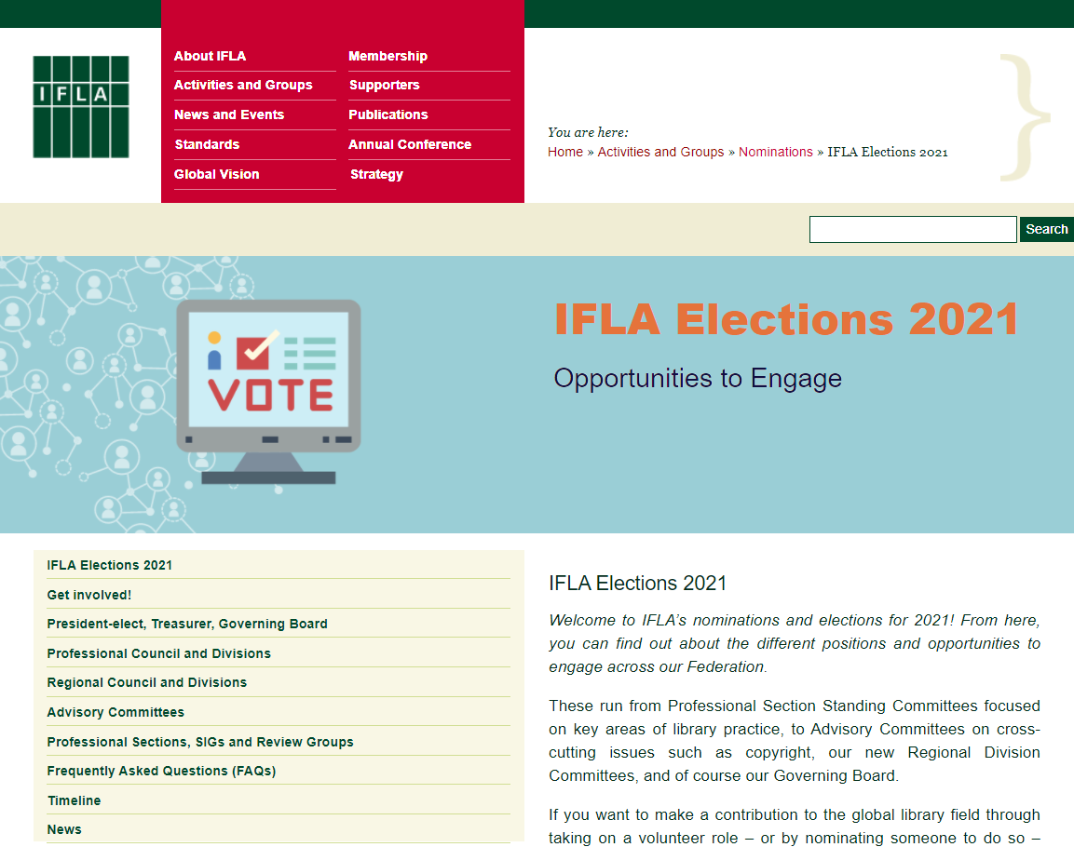
https://www.ifla.org/elections-2021

Slide 15
Nominations Process: Key Considerations
We want this to be the strongest, most diverse range of candidates ever!
Each role requires both a nominee and a nominator*
Nominators should fill in a nominator form (you should have received the link)
Nominees should fill in a nominee consent form (once you know you have enough nominators)
You can make as many nominations as there are places available
Deadline: 13 April, 12pm CEST
* With the exception of Special Interest Group Committee Members, where only a nominee consent form is needed

Slide 16
Summary: Association Members can nominate for
President-elect, Treasurer, Governing Board Members, Regional Council Chair
Professional Section Standing Committee members (for Sections for which you are registered)
Regional Division Committee members in your region
Advisory Committee Chairs and members*
Review Group members
* Only National and International Association Members

Slide 17
Institution Members can nominate for
President-elect, Treasurer, Governing Board Members, Regional Council Chair
Professional Section Standing Committee members (for Sections for which you are registered)
Regional Division Committee members in your region
Advisory Committee members
Review Group members

Slide 18
Affiliates (Association, Institution and Personal) can nominate for:
President-elect, Treasurer, Governing Board Members, Regional Council Chair
Professional Section Standing Committee members (for Sections for which you are registered)
Regional Division Committee members in your region

Slide 19
Professional Section Standing Committee Chairs and Secretaries can nominate for:
Professional Council Chair
Professional Section Standing Committee members can nominate for:
Professional Division Committee Chairs

Slide 20
See our elections webpages for more
https://www.ifla.org/elections-2021

Slide 21
Questions and Answers:
Nominations Process

Slide 22
Questions and Answers:
General Questions

Slide 23
24 May, 12pm CEST: Closing of Elections for President-elect, Treasurer, Governing Board members-at-large, Regional Council Chair, Regional Division Committee members, Section Standing Committee members
31 May, 12pm CEST: Closing of Elections for Professional Council Chair and Professional Division Committee Chairs
26 April: Announcement of Candidates and Opening of Electronic Voting for President-elect, Treasurer, Governing Board members-at-large, Regional Council Chair, Regional Division Committee members, Section Standing Committee members
13 April, 12pm CEST: Nominations Close:
3 May: Announcement of Candidates and Opening of Electronic Voting for Professional Council Chair and Professional Division Committee Chairs
14 June: Publication of Results for Professional Council Chair and Professional Division Committee Chairs
1 June: Publication of Results for President-elect, Treasurer, Governing Board members-at-large, Regional Council Chair, Regional Division Committee members, Professional Section Standing Committee members
June – August: Nominations and publication of candidacies for elections held within Committees
Day following the IFLA General Assembly in August 2021: New Committees take office
Next Steps
#WeAreIFLA

Slide 24
We Are
IFLA
#WeAreIFLA

